Slide 1

Credit Card Fraud Detection
Predictive Modeling – Praveen G

Slide 2
Agenda
DataQuality Check
Descriptive Analysis
Dependent Variable Analysis
Univariate Analysis
Bivariate Analysis
Modelling - Supervised & Unsupervised
AutoEncoders
Summary

Slide 3

DaTa QUALITY – null check

Slide 4
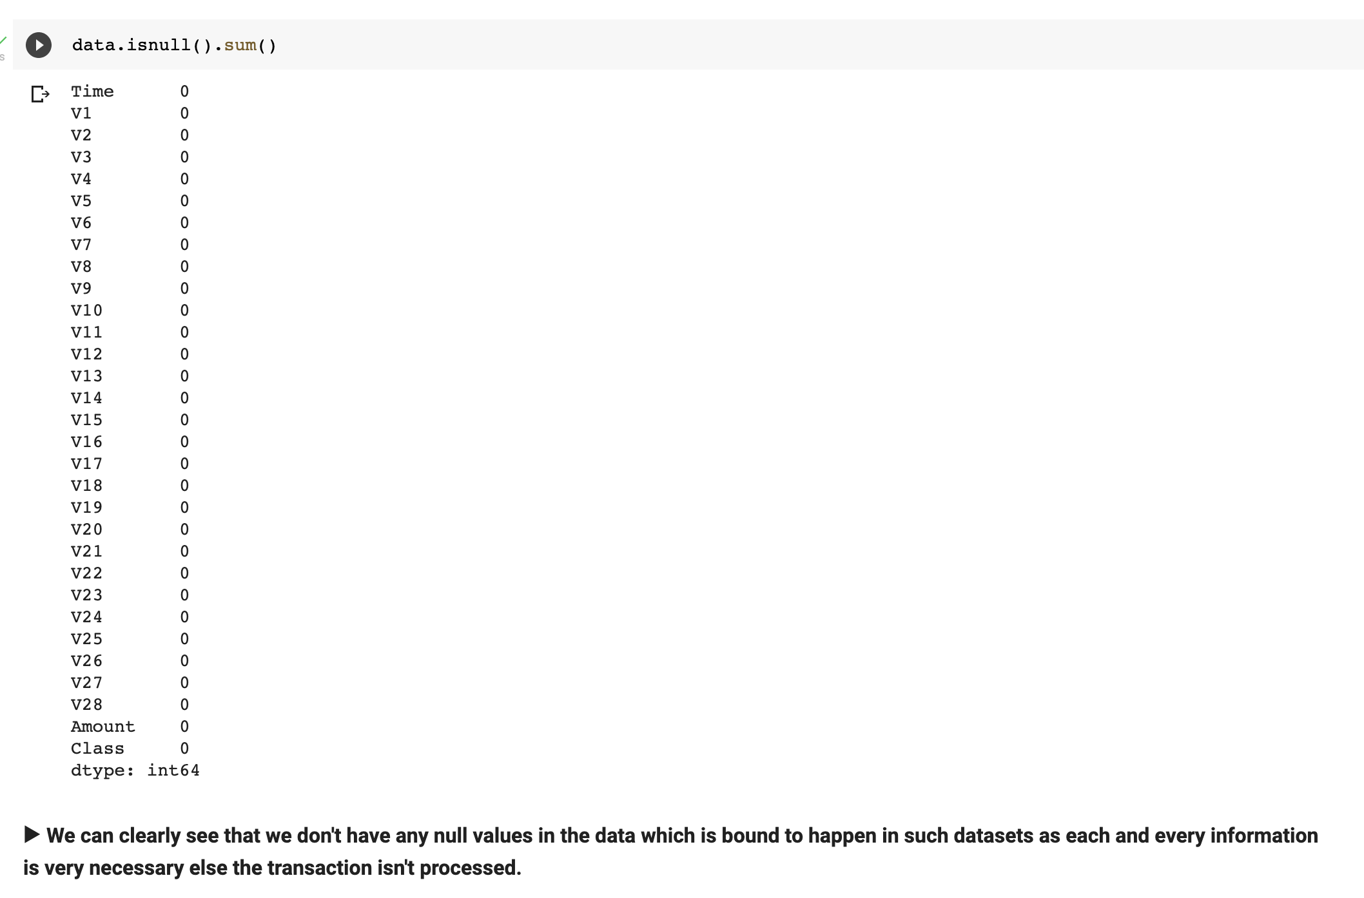
No Null values in dataset

Slide 5

Descriptive analysis

Slide 6
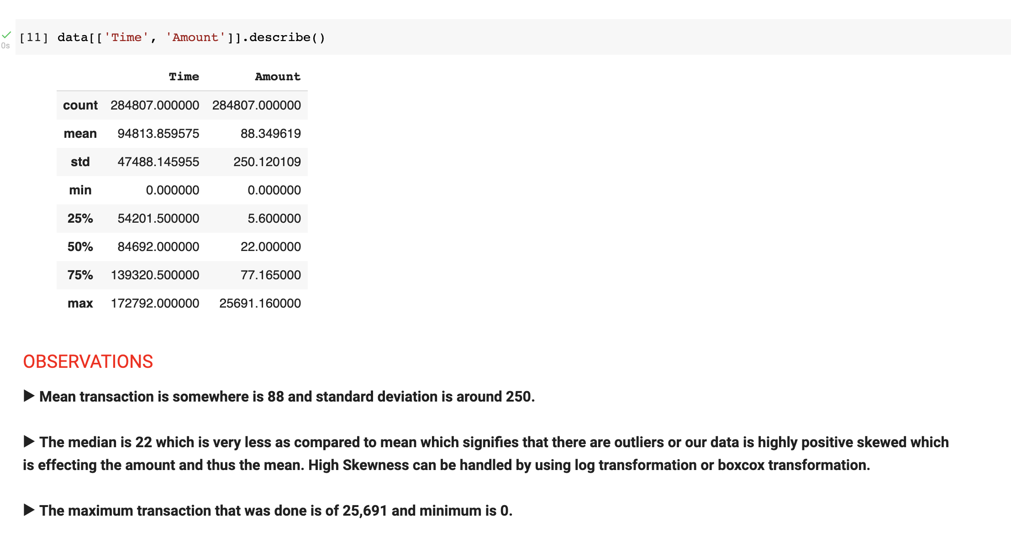

Slide 7
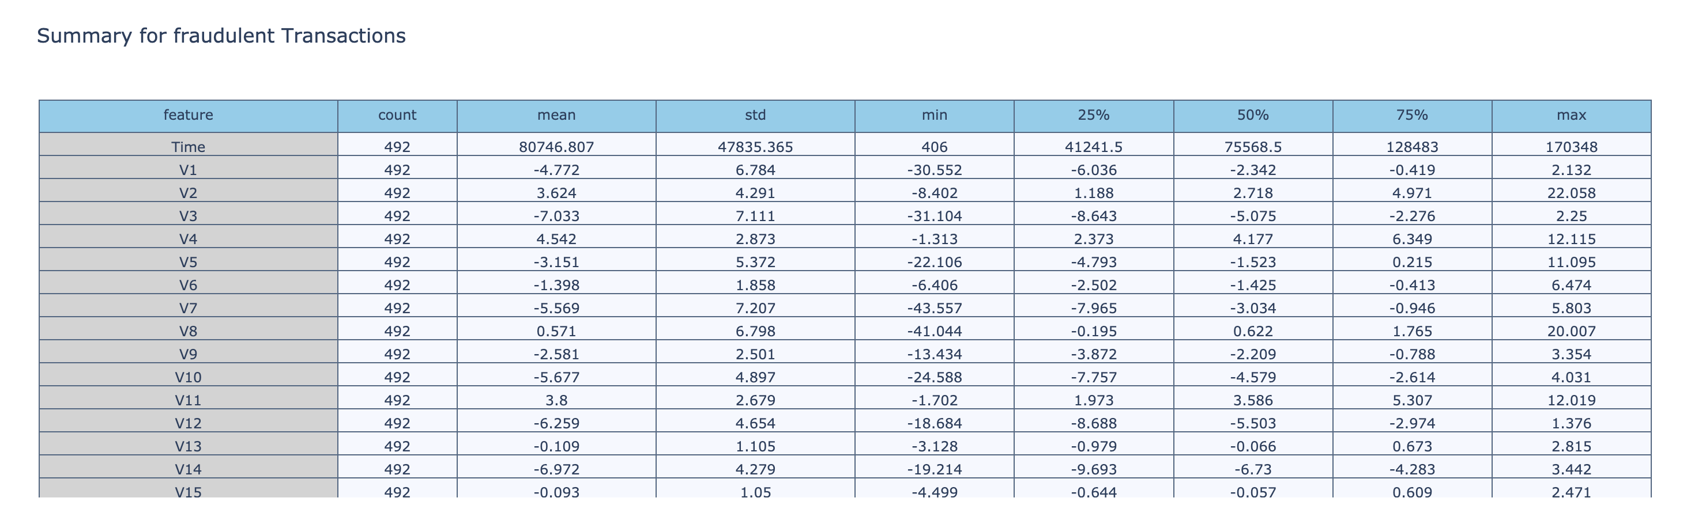
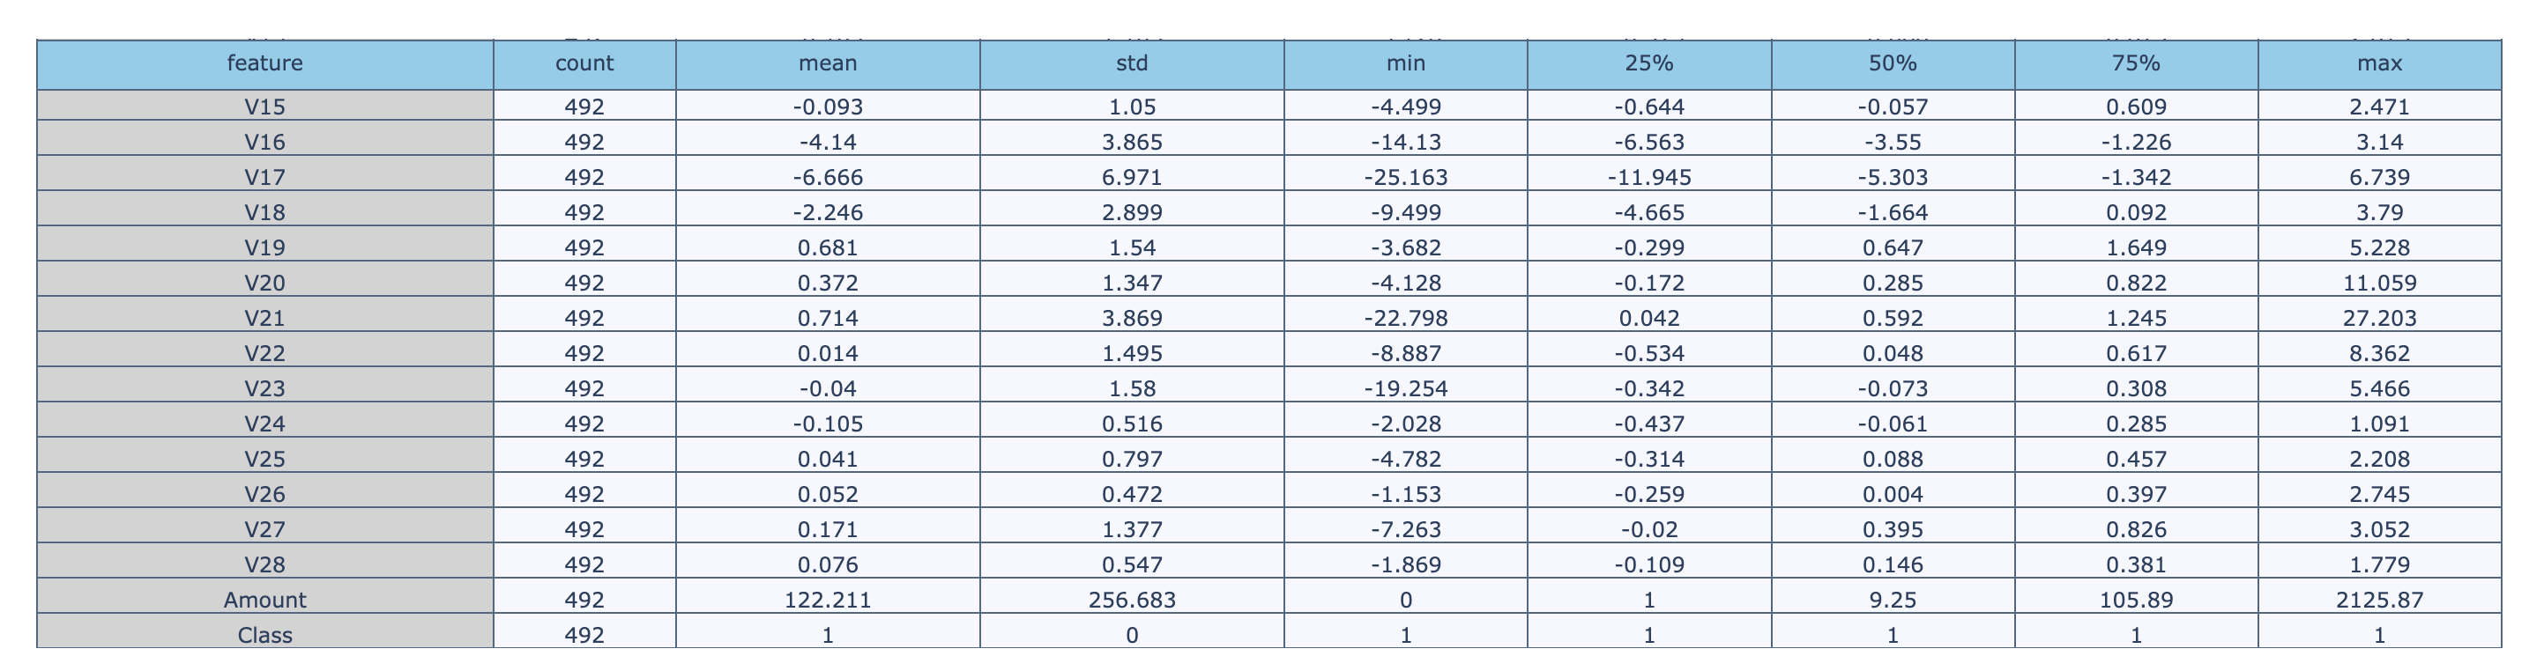
Descriptive statistics of of frauds transactions

Slide 8
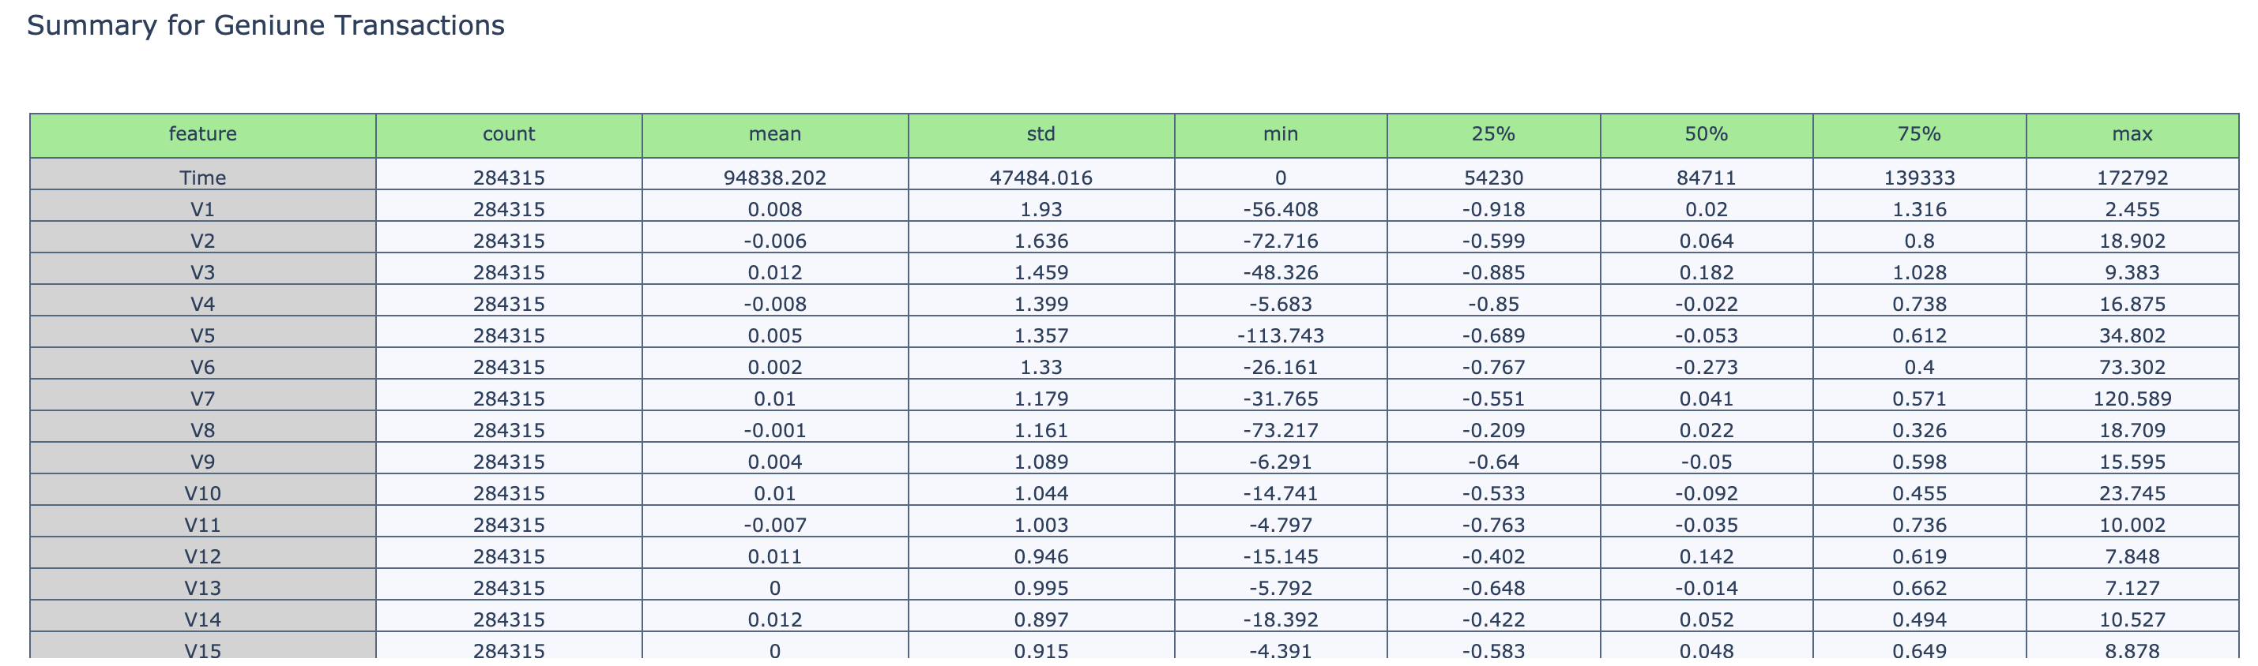
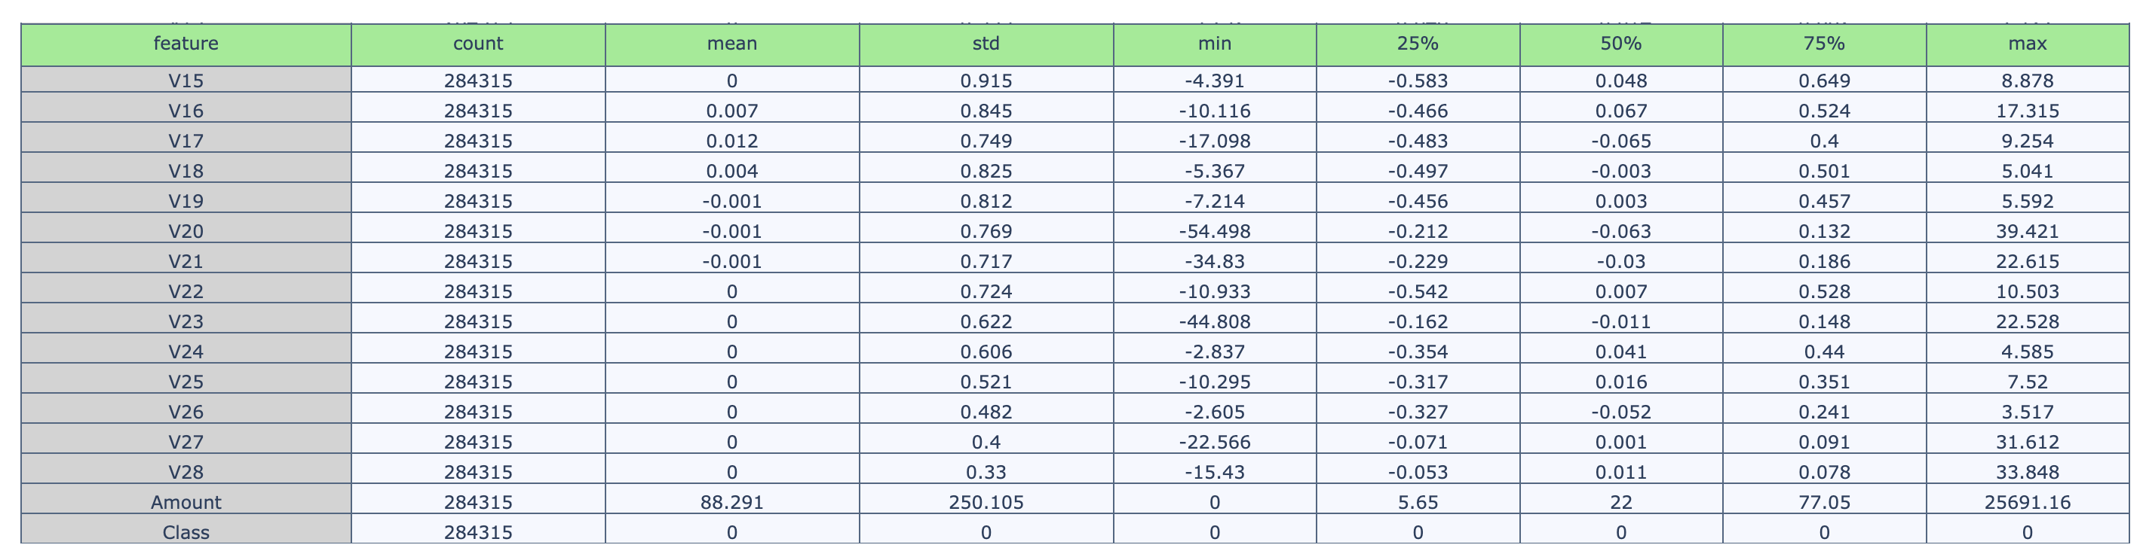
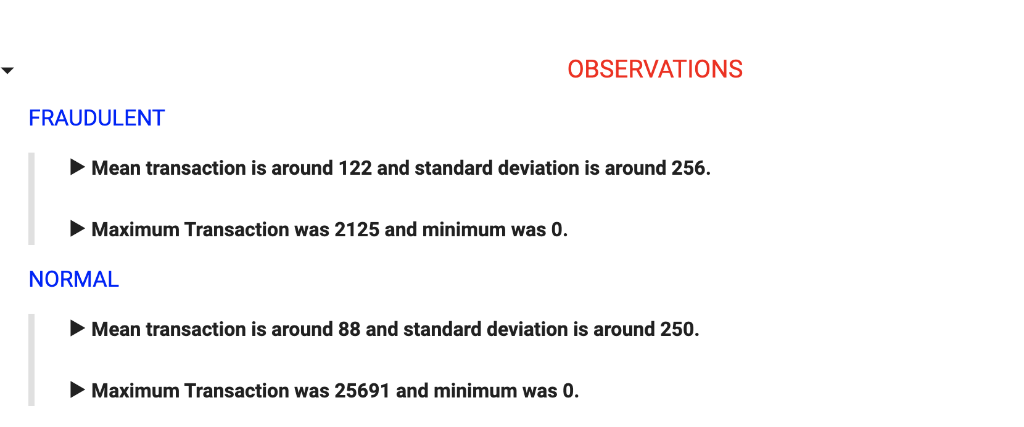
Descriptive statistics of of GEnuine transactions

Slide 9
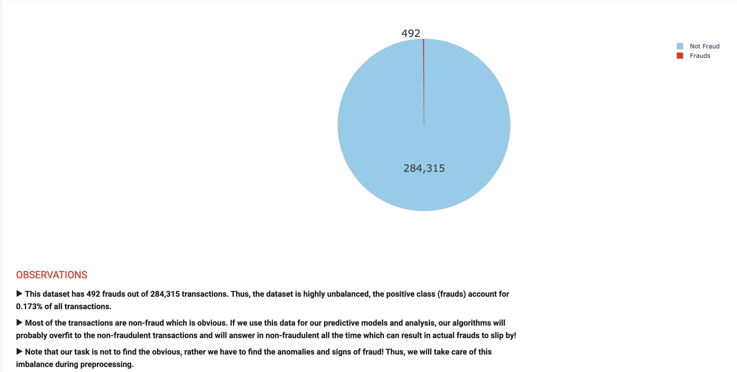
Percentages of fraudulent and non-fradulent transactions in data
Percent of Non-Fraudulent Transactions = 99.827%
Percent of Fraudulent Transactions = 0.173%

Slide 10
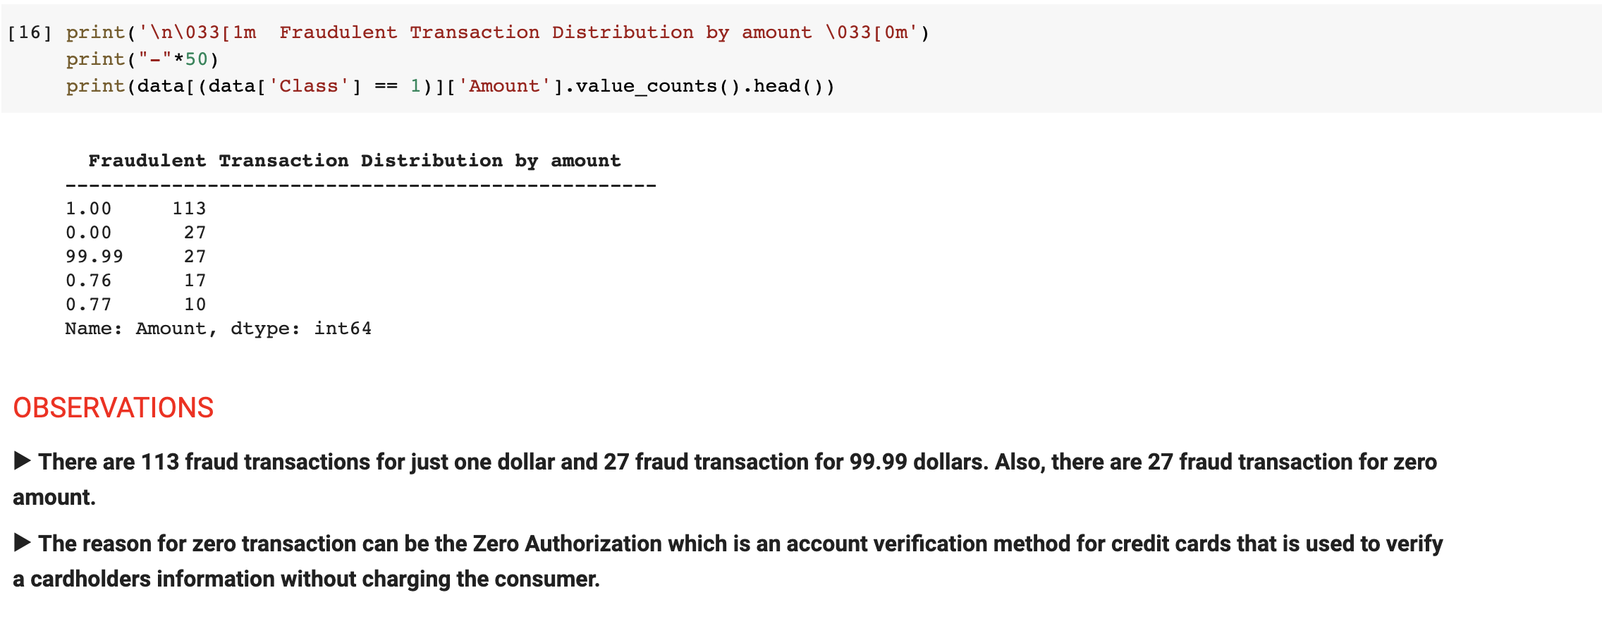
Insights

Slide 11

Univariate analysis

Slide 12
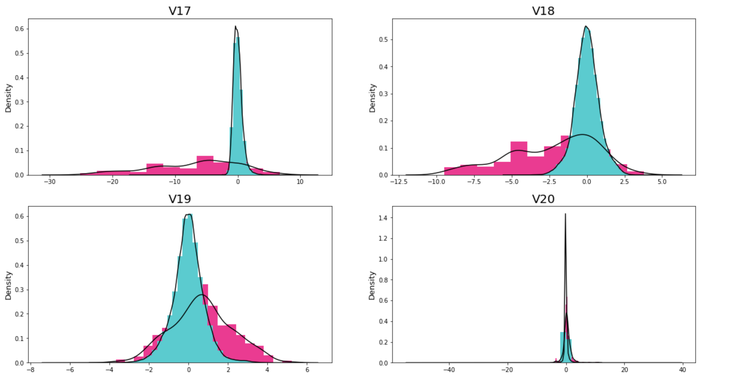
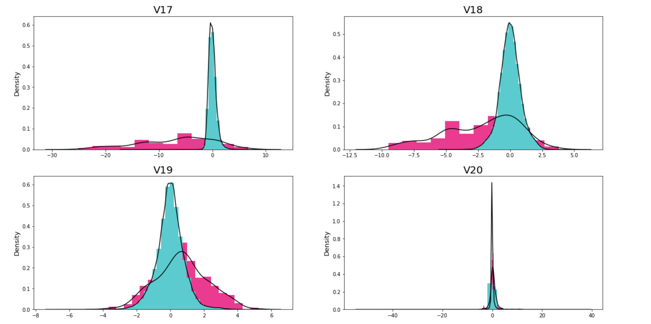
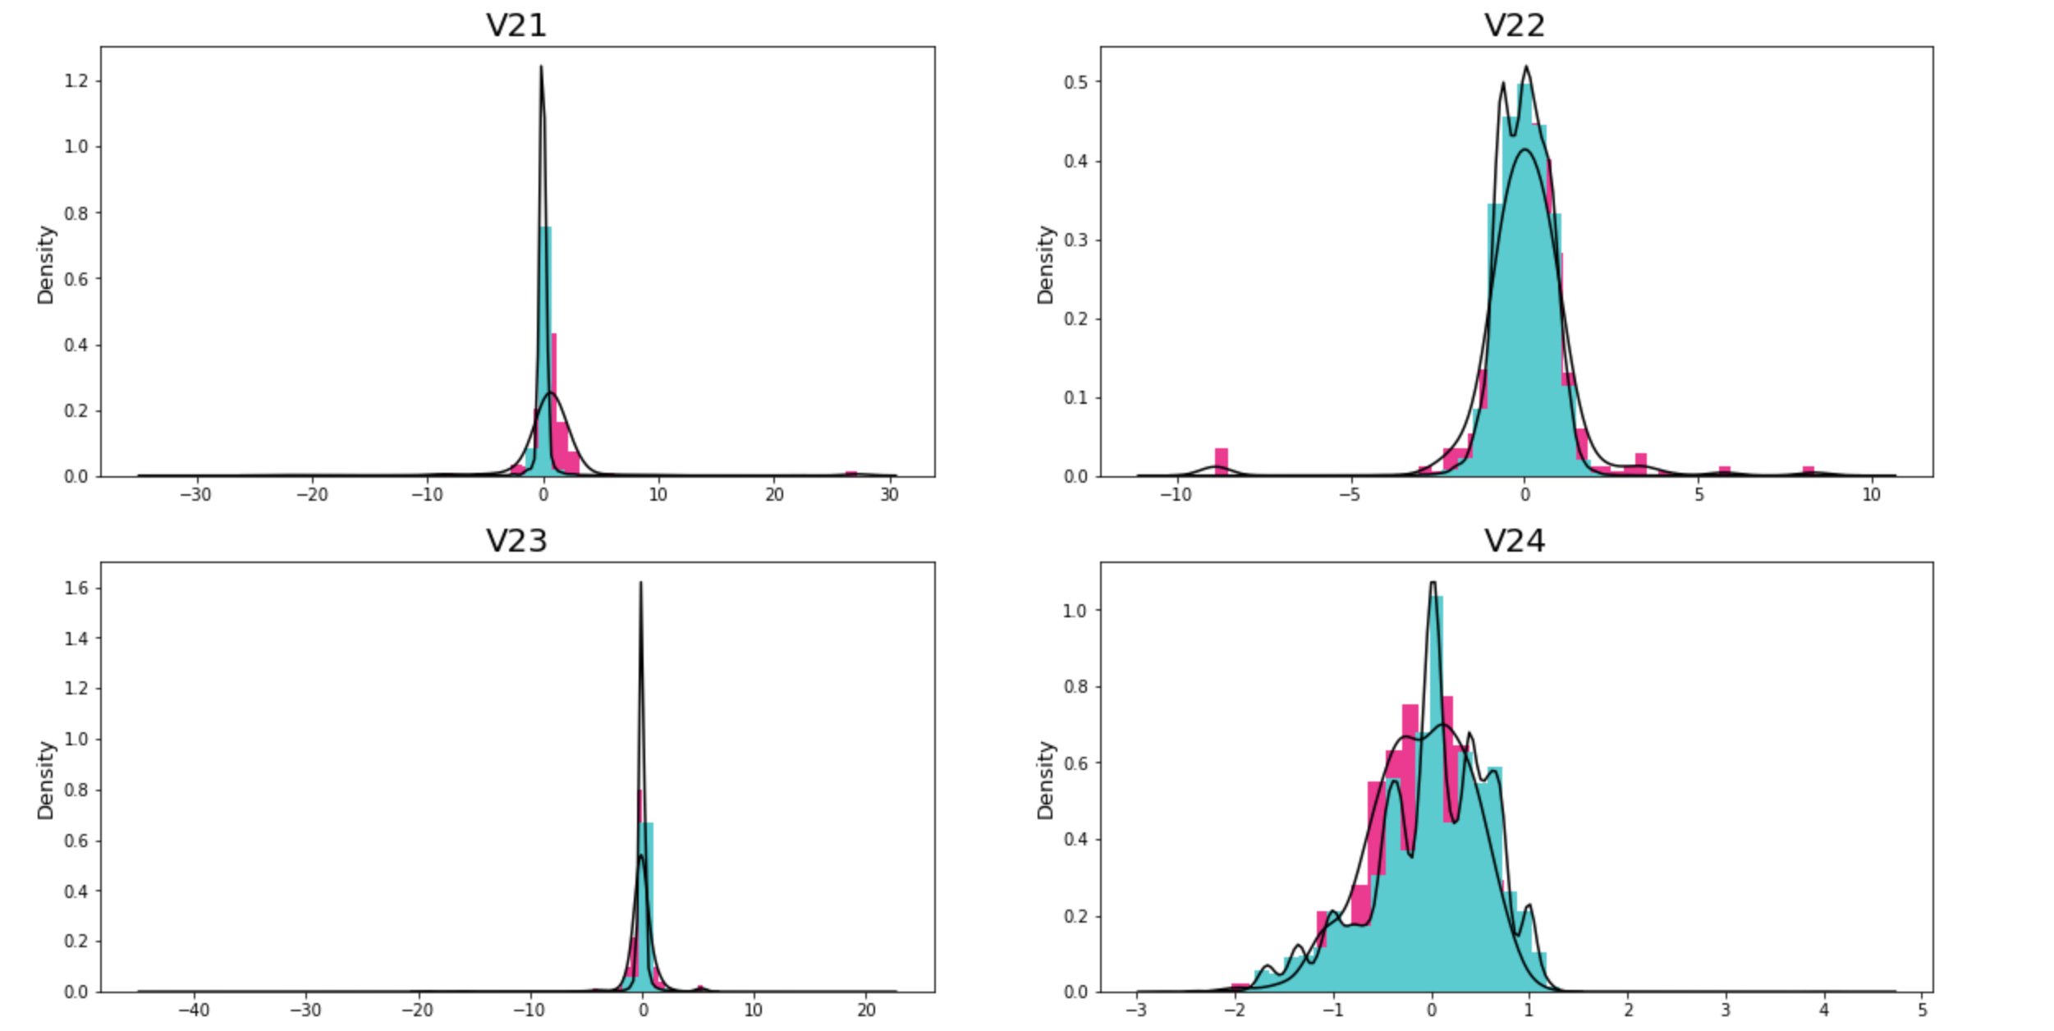
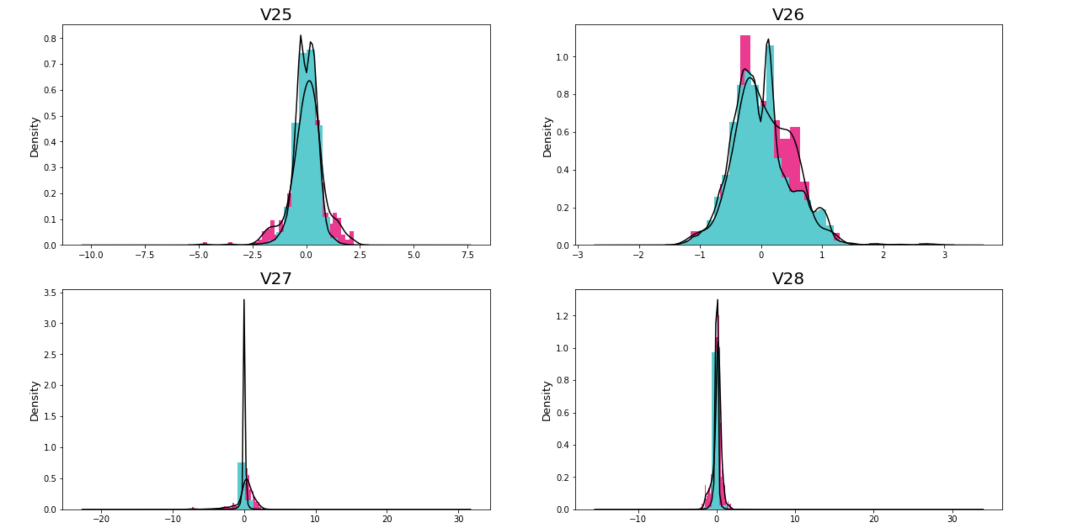

Slide 13
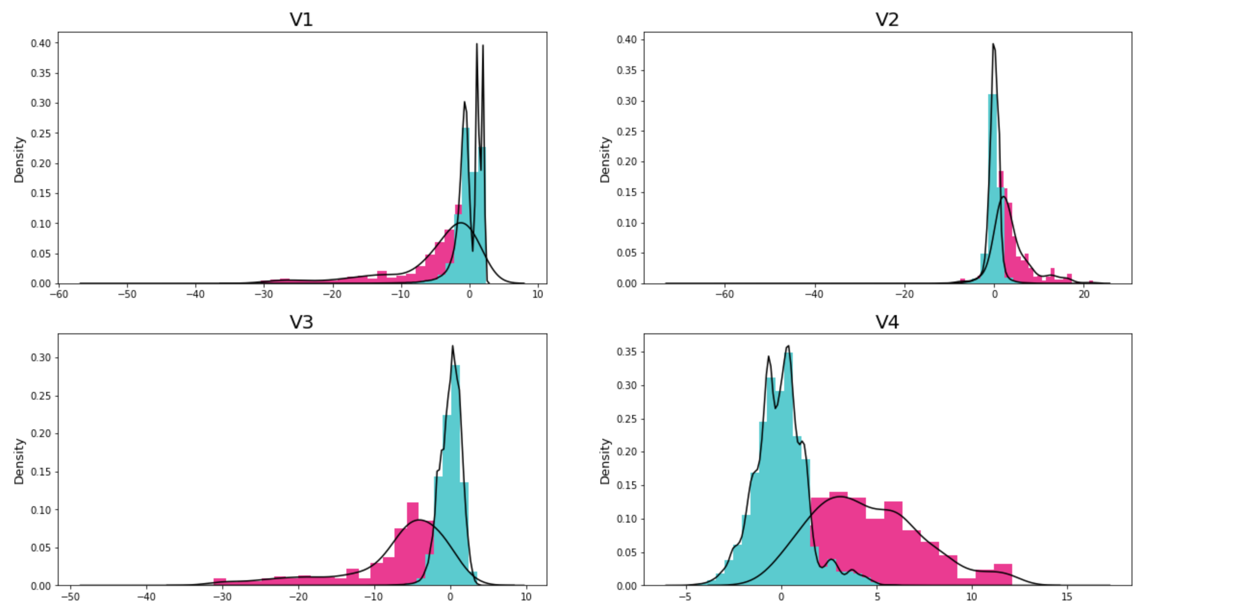
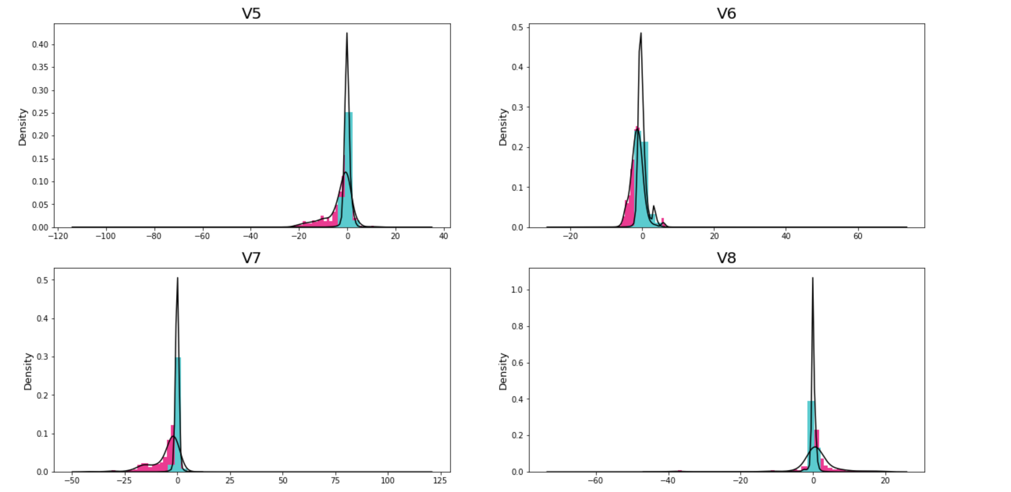
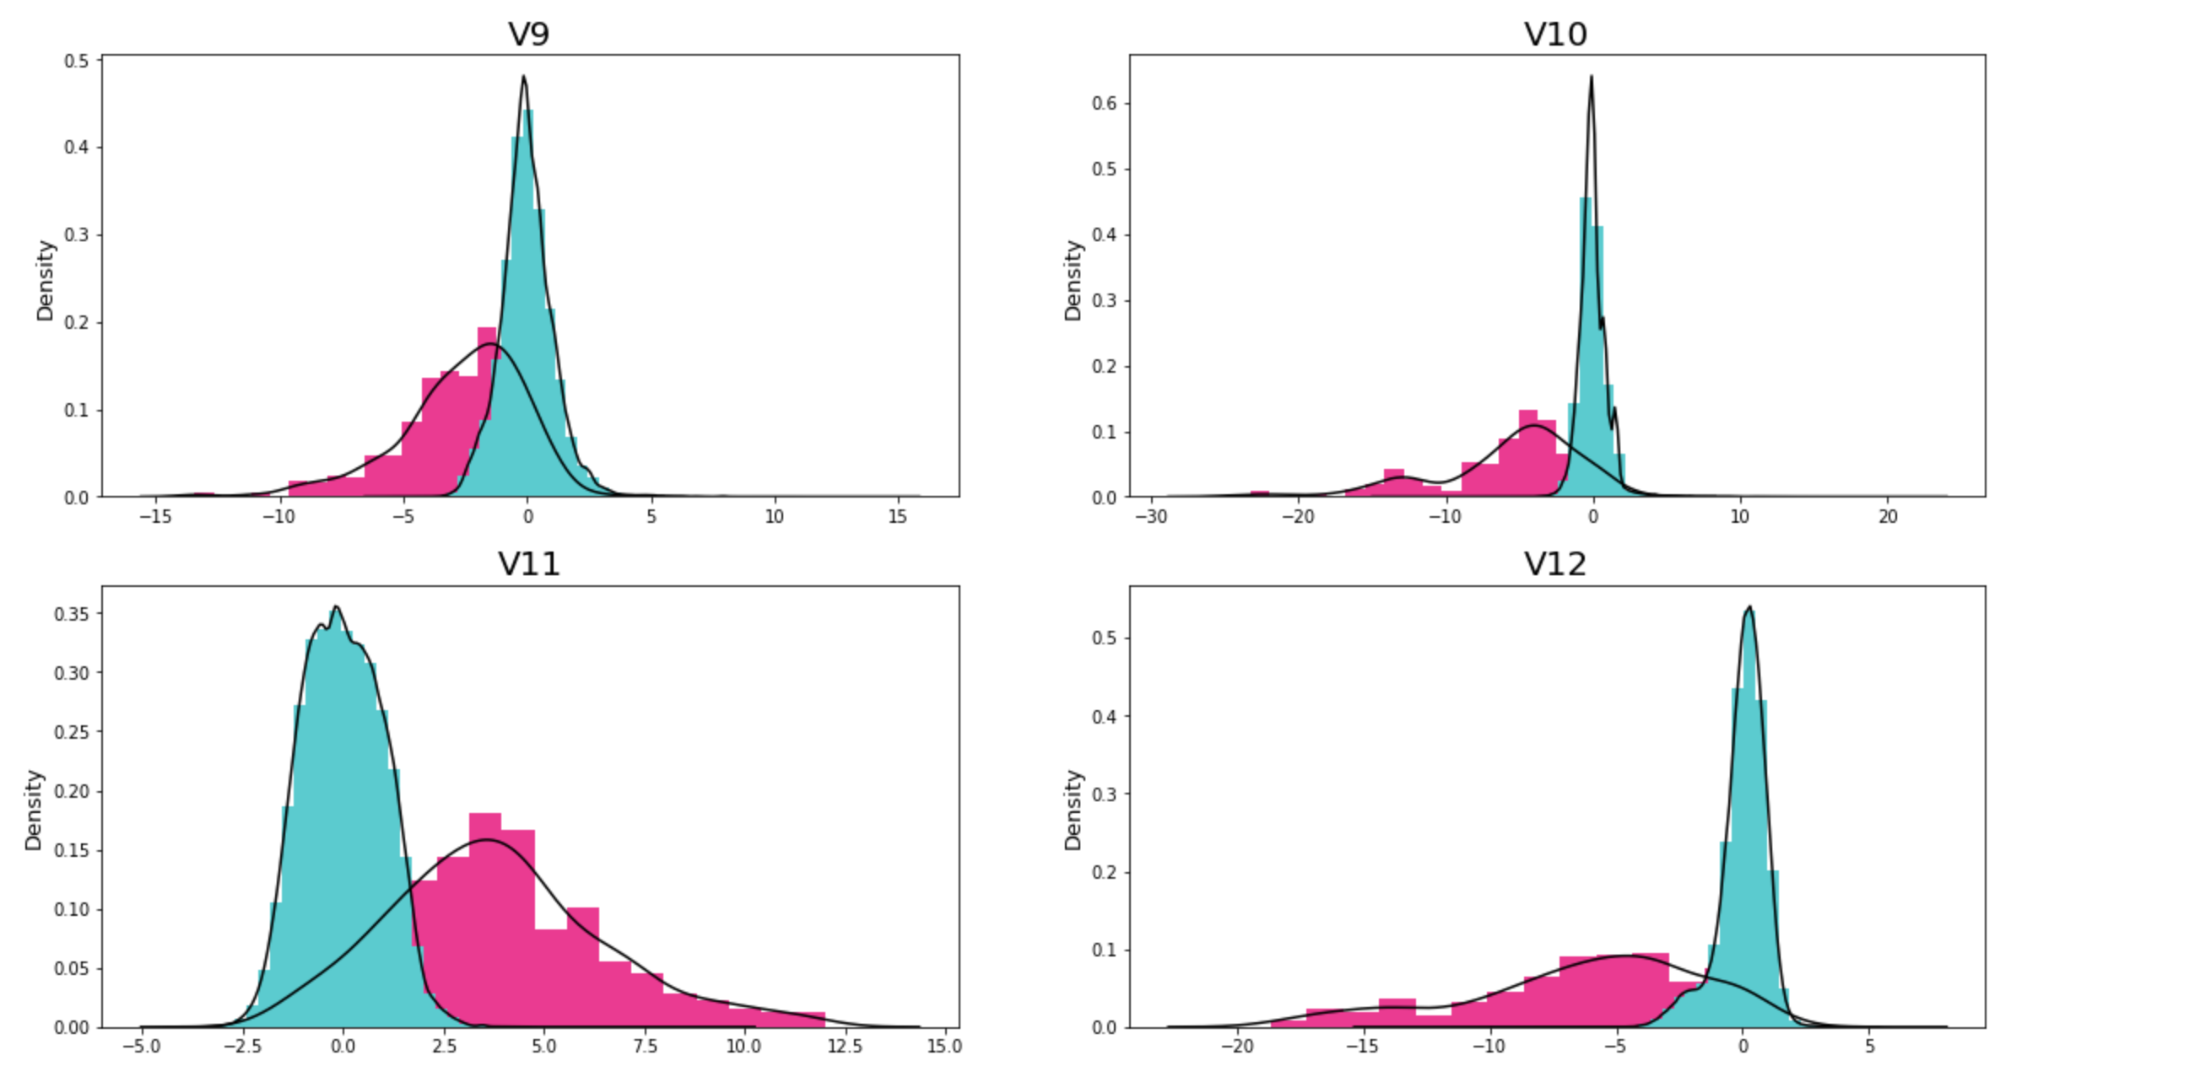
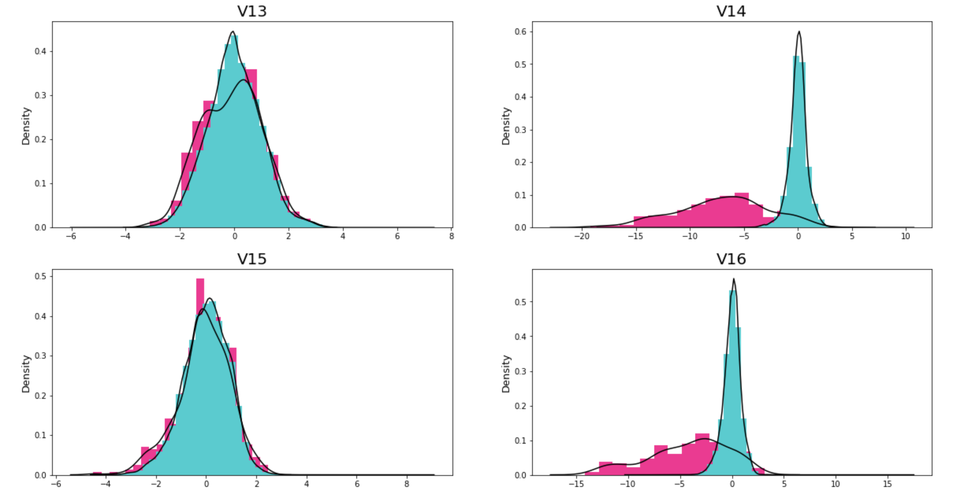

Slide 14
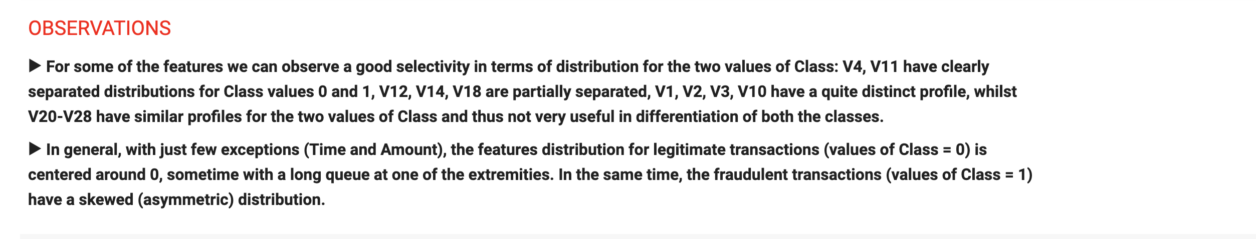
Summary

Slide 15

Heatmap for explainatory variables

Slide 16
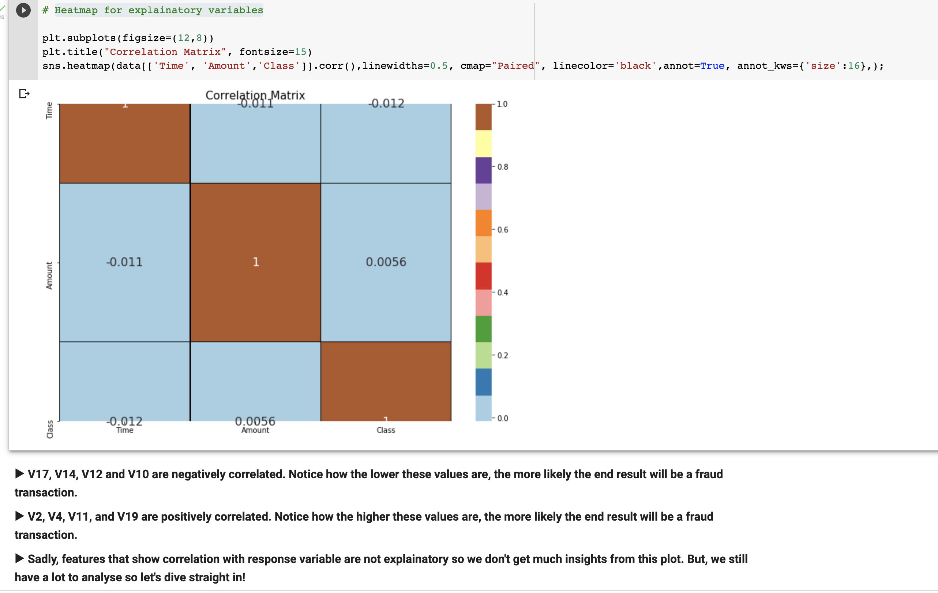

Slide 17

distribution of the classes with respect to time for both fraudulent and normal transactions.

Slide 18
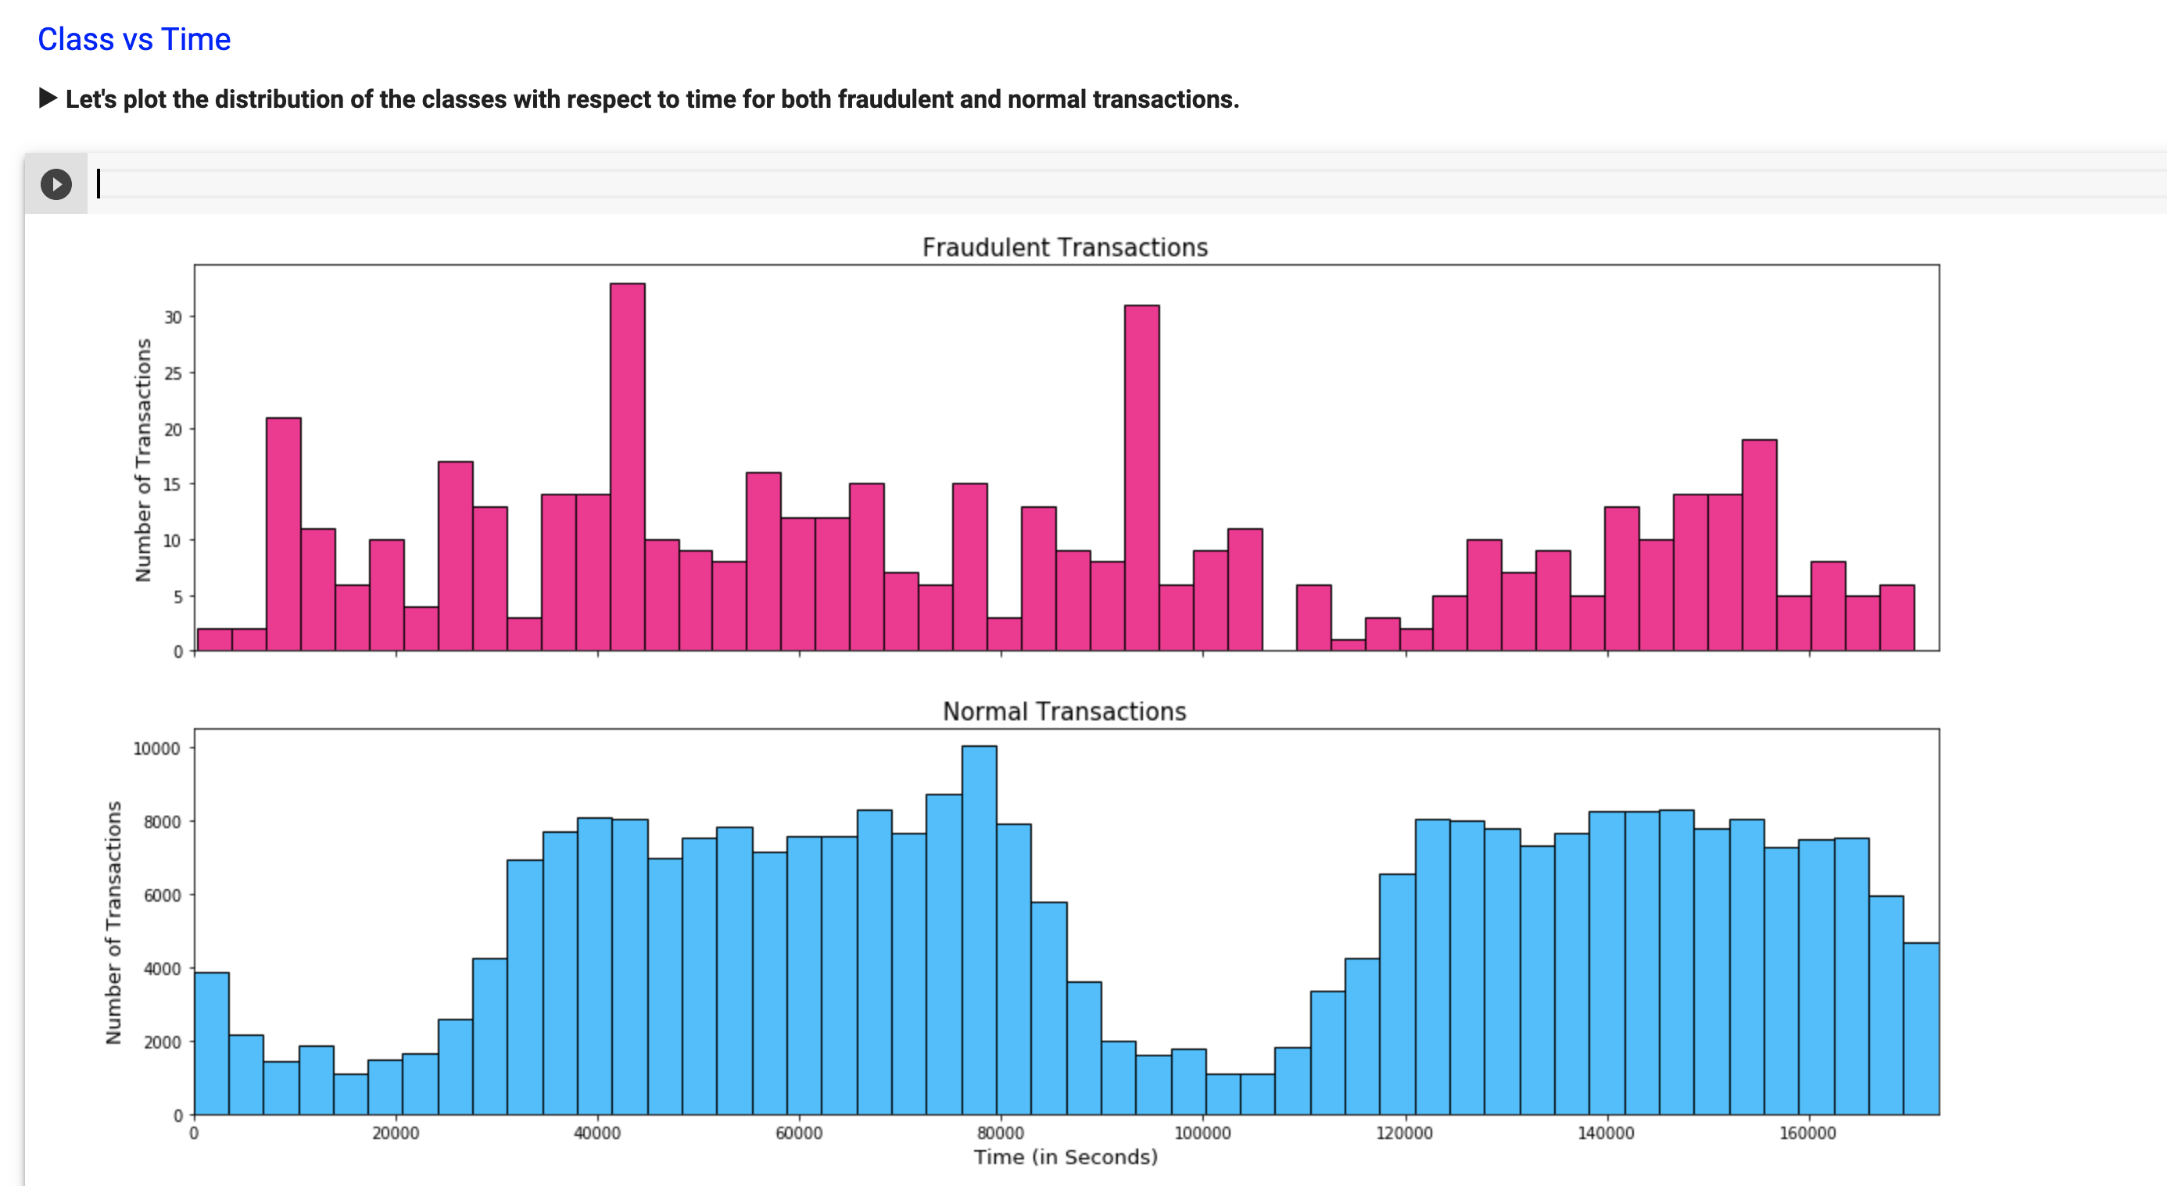
FRAUDULENT
► There are two peaks between 40000 seconds and 100000 seconds which were the maximum number of fraudulent transaction at any time.
NORMAL
► Normal transactions have not much to uncover except the fact that there were less transactions somewhere around 20000 seconds and 100000 seconds which is not very useful.

Slide 19
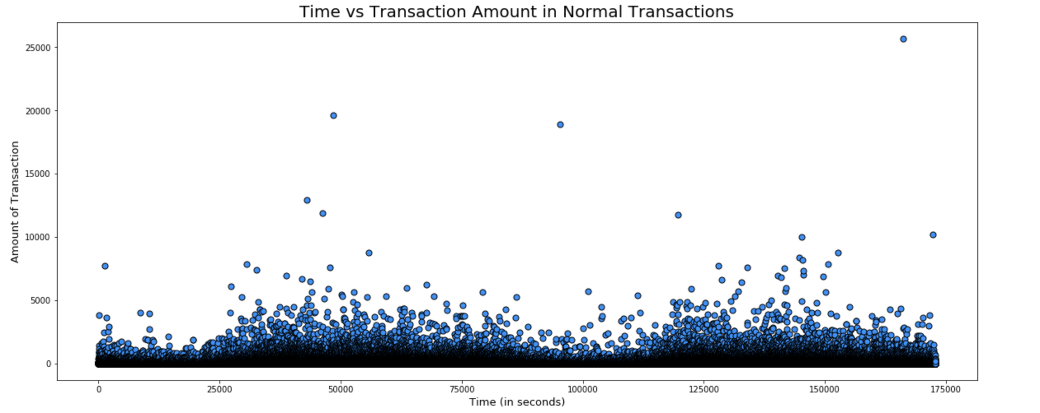
Txn amount genune vs time

Slide 20
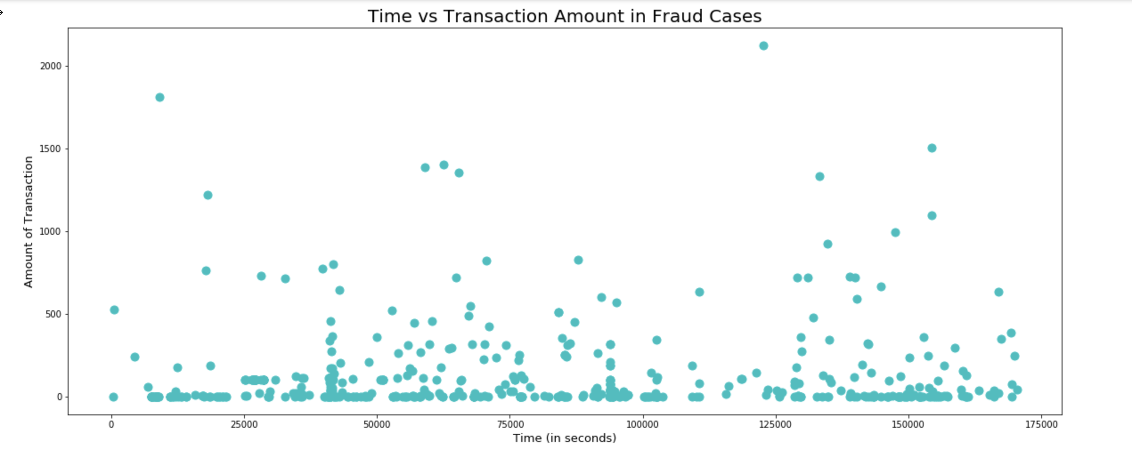
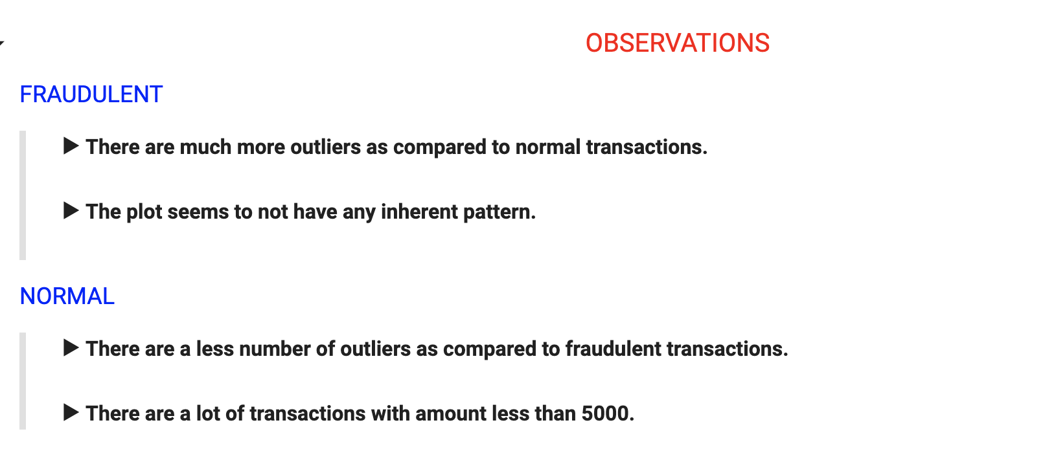
Txn amount FRAUD vs time

Slide 21

Data Cleaning and Preprocessing

Slide 22
Outlier Removal
► As we already saw that amount column has a extreme outliers so it necessary to remove them as they can effect the model's performance. We will used Interquartile range to detect outliers which removes anything below the lower limit (25 percentile) and anything above upper limit (75 Percentile).
► Note that, the data we have for fraudulent cases is very low so we wanna keep our cutoff a bit high so as avoid removing much of the fraud cases. Here, as the data is skewed (kind of exponential) so having high cutoff will help us. Let's take the cutoff value as 5.0 instead of 1.5 which is usually used.

Slide 23
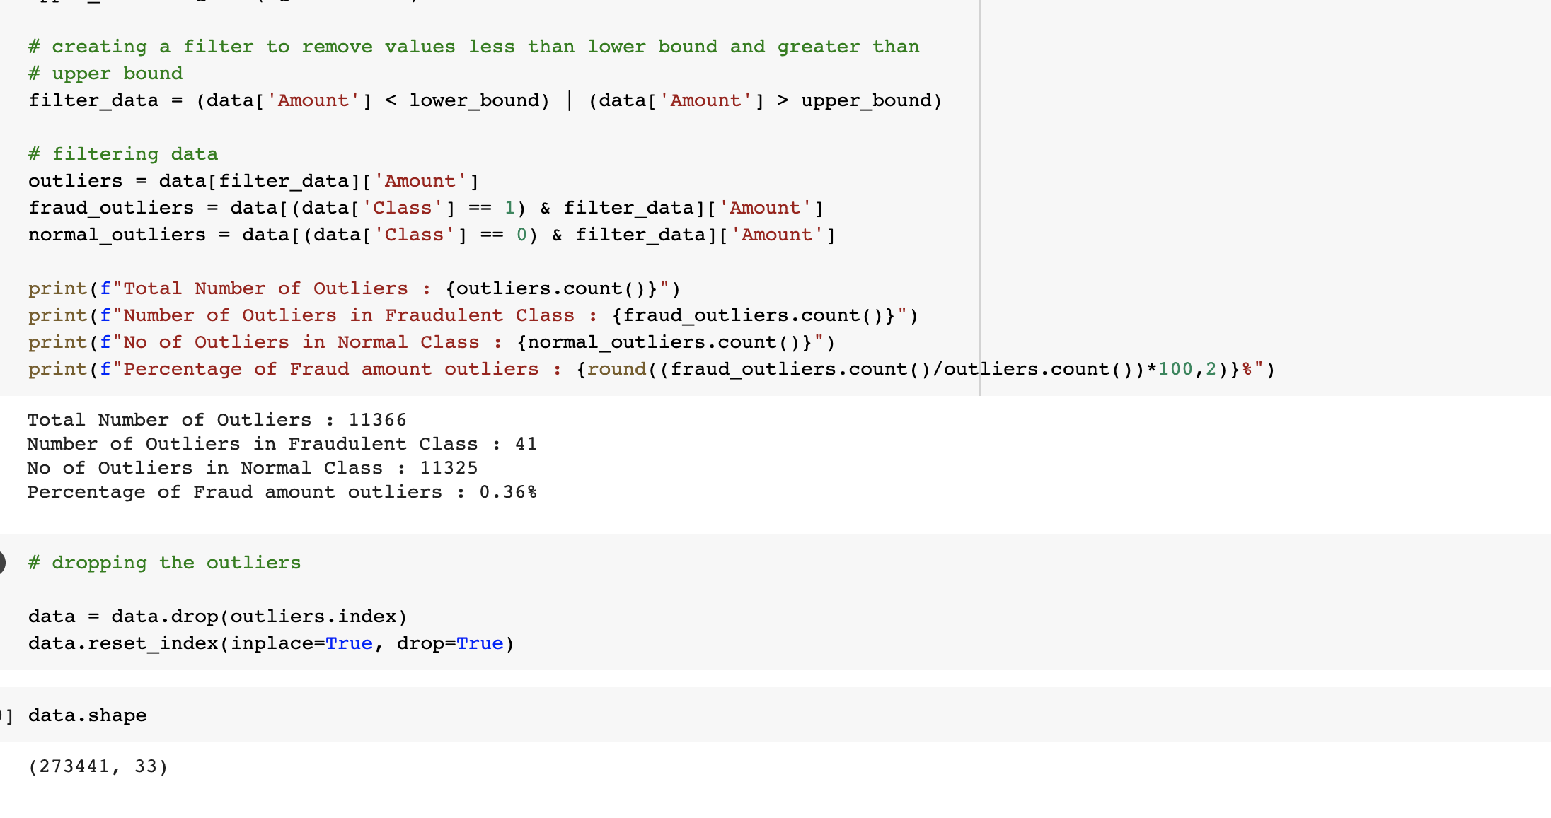

Slide 24

Feature Scaling

Slide 25
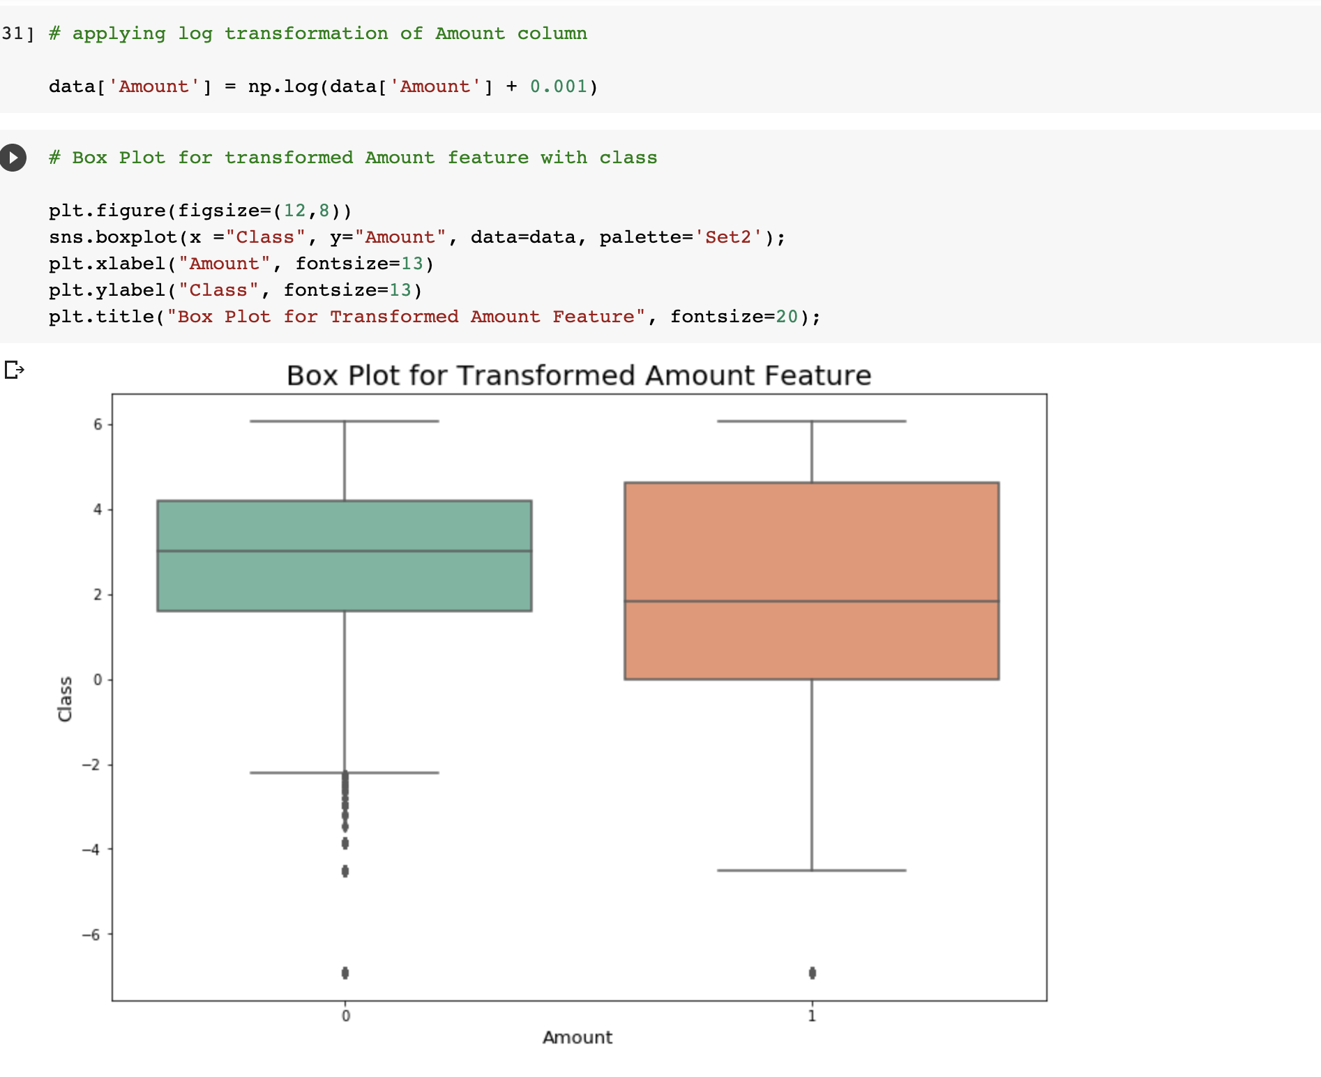
Transorning amount field

Slide 26
Handling Class Imbalance
Oversampling
Undersampling
SMOTE

Slide 27
Sampling technique
► Out of all these three SMOTE is the most effective so we will go with it, In this technique, instead of simply duplicating data from the minority class, we synthesize new data from the minority class. This is a type of data augmentation for tabular data can be very effective. This approach to synthesizing new data is called the Synthetic Minority Oversampling Technique, or SMOTE for short.

Slide 28

Modeling

Slide 29
Logistic Regression
► Let's start off with a simple model like Linear Regression. Note that I will be doing cross validation using Randomized search as the data is very huge and we will do this cross validation after splitting to avoid Data Leakage as discussed above.

Slide 30
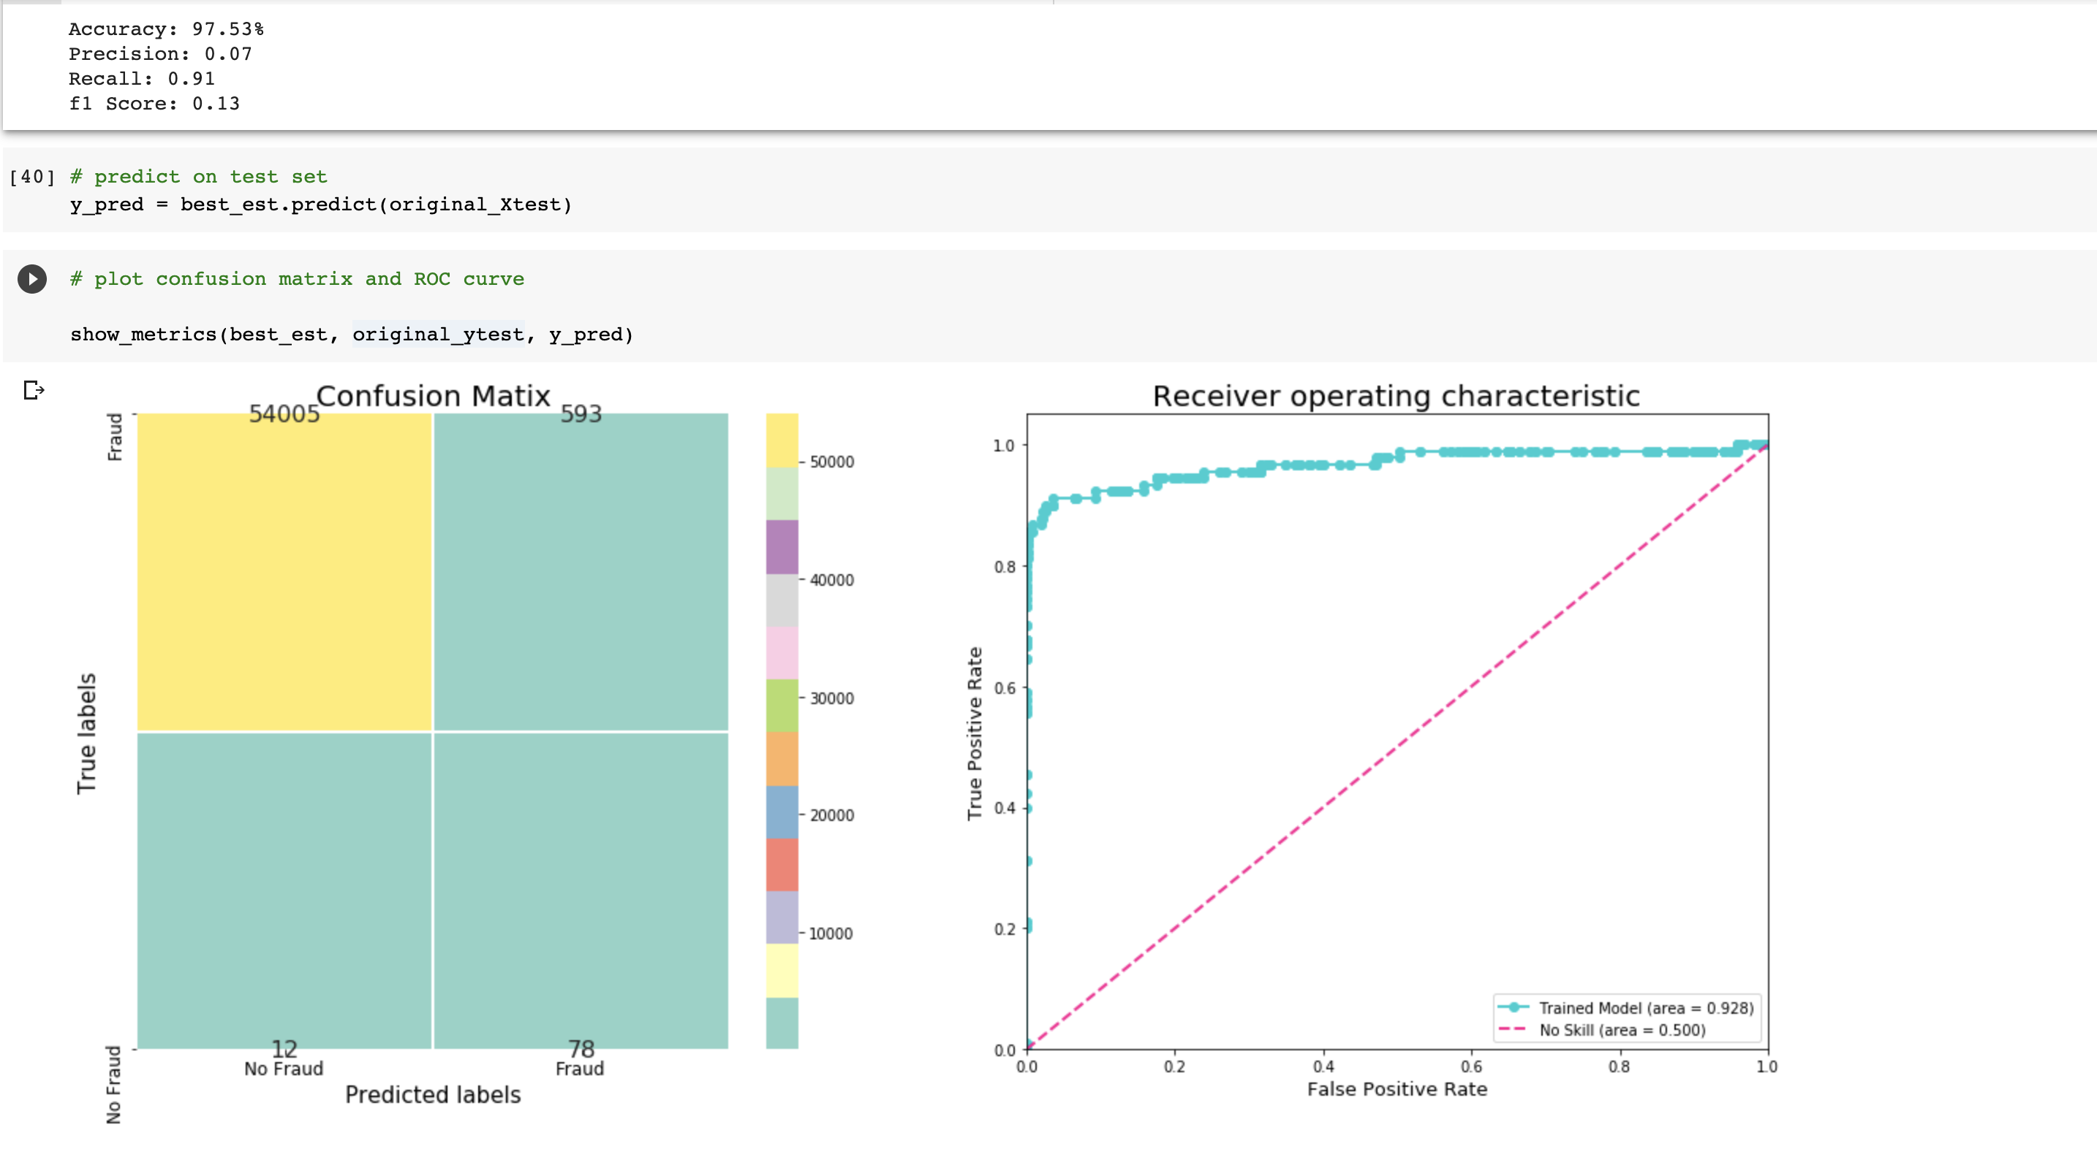
Logistic regression did really well on the fraud class giving almost 97.5% accuracy and algo does well on the fraud class, predicting
78 fraud cases are correct
12 cases as wrong
so we still have a room for improvement. It we applied model to the imbalanced data instead then it results would be pathetic.

Slide 31
Random Forest Classifier
► Now, let's try something which can take account of complex relationships. There are many such models but Random forest is bit better as it is a ensemble model and focuses on reducing variance i.e overfitting without much effecting the bias which is all we want. Also, this algorithm works in time complexity, O(d.n.log(n)) where d is the number of features.
► I have shown the best parameters after GridsearchCV and not the whole process itself as it is very time consuming and takes forever so you can try it yourself.

Slide 32
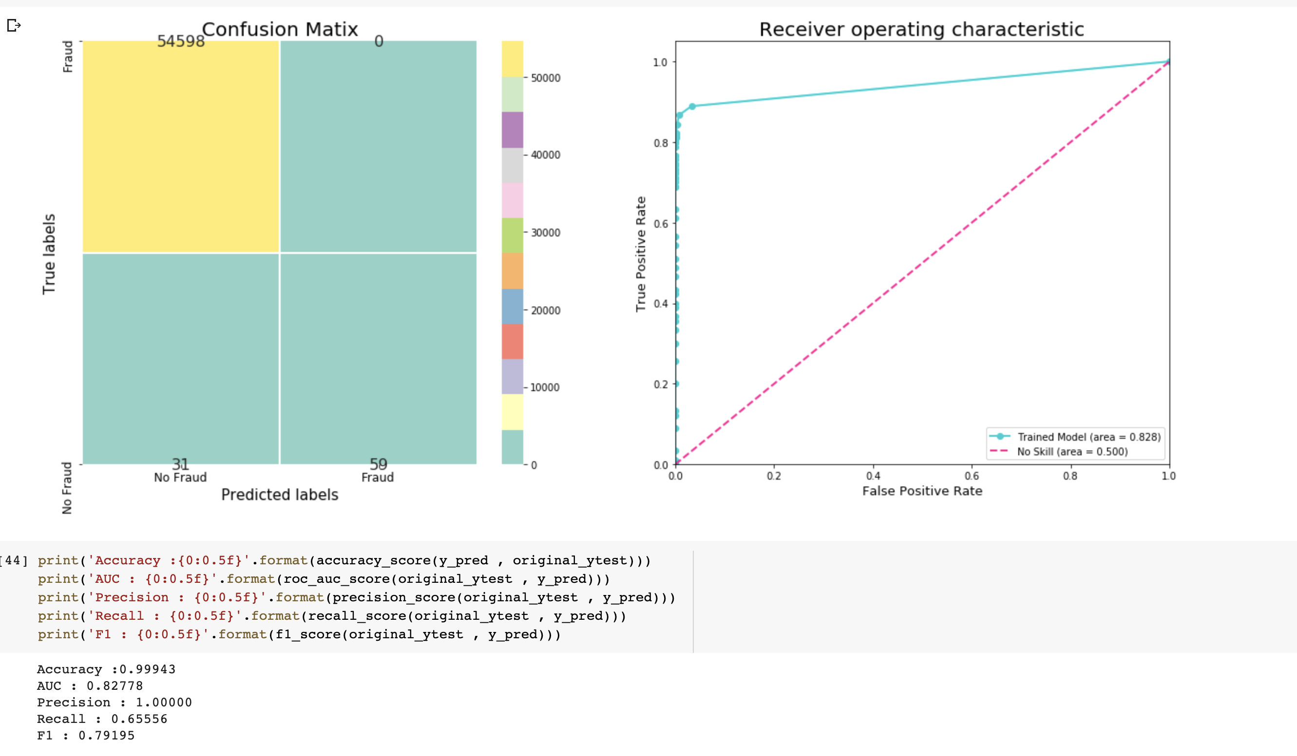
Precision and accuracy are good but the recall is pretty low due the which the model is not performing well on fraudulent data.

Slide 33
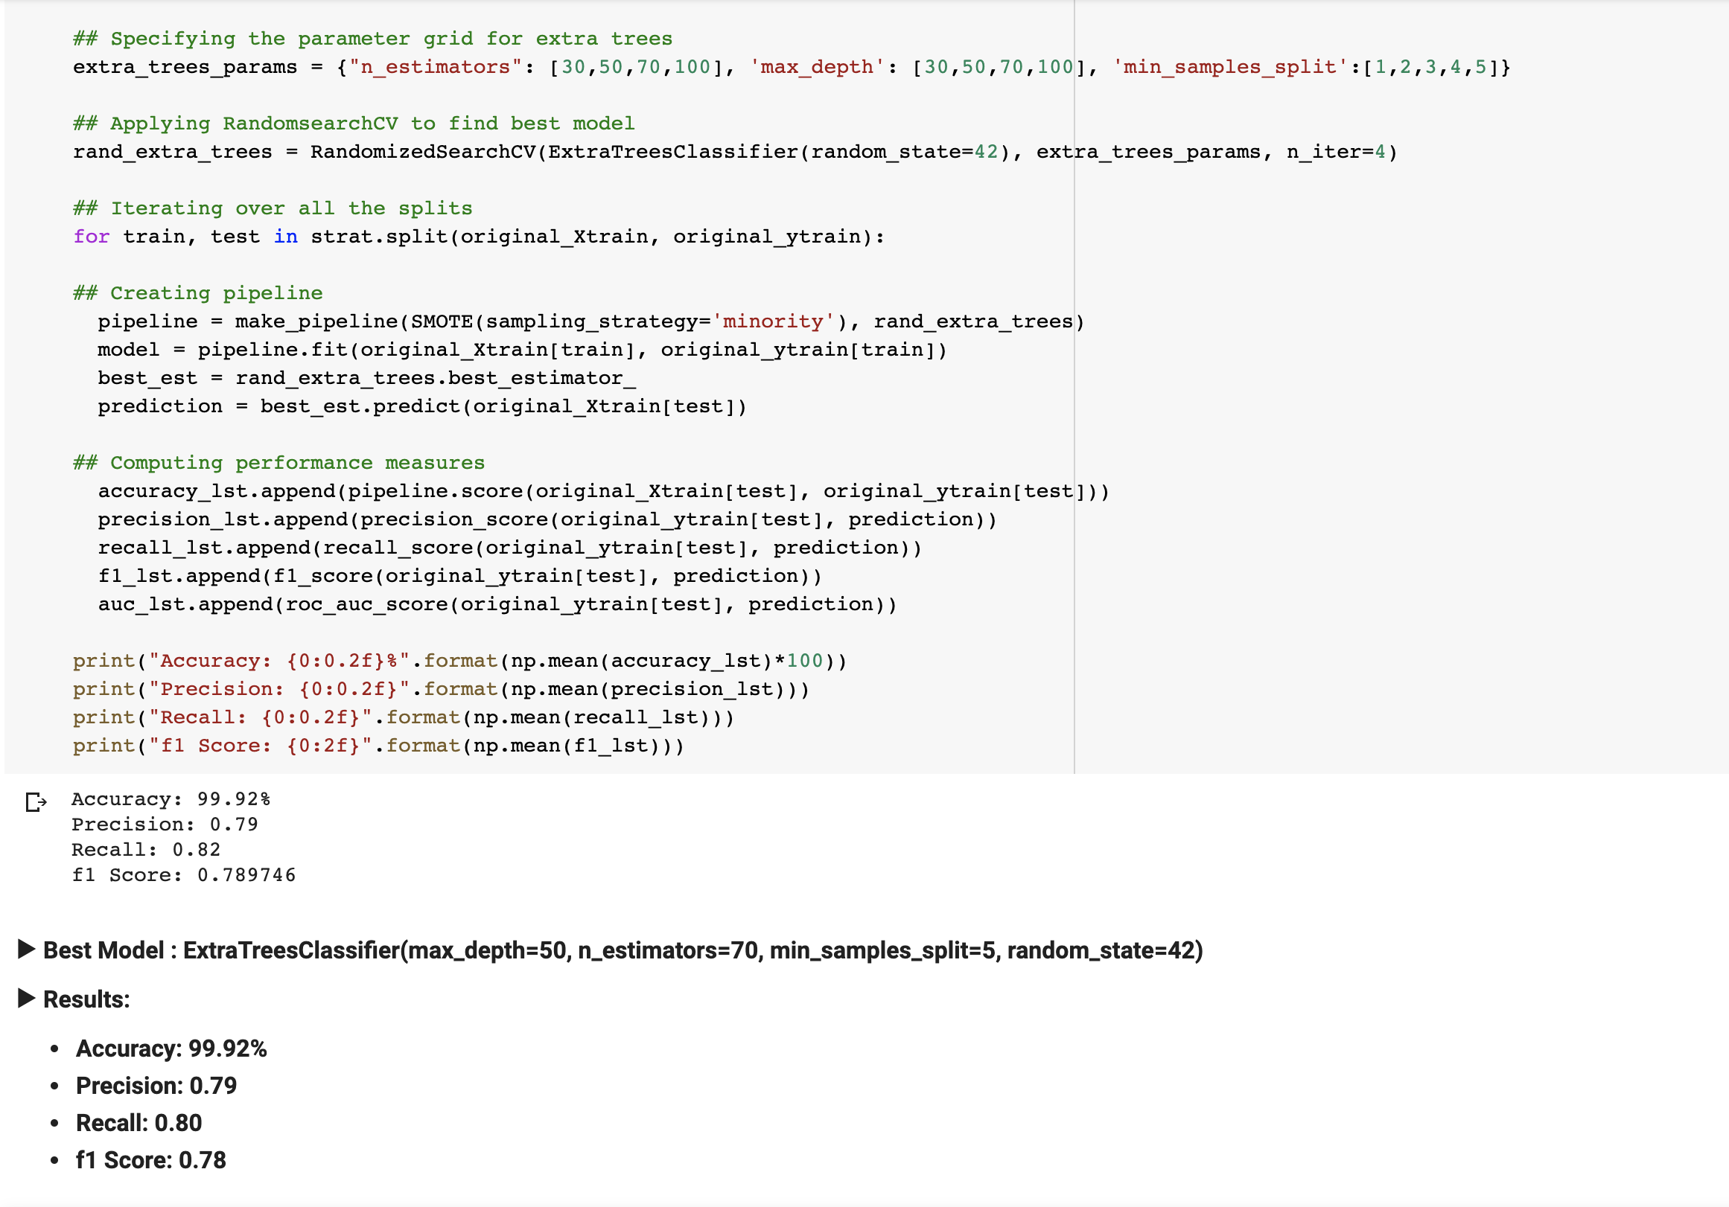
ExtraTrees Classifier

Slide 34
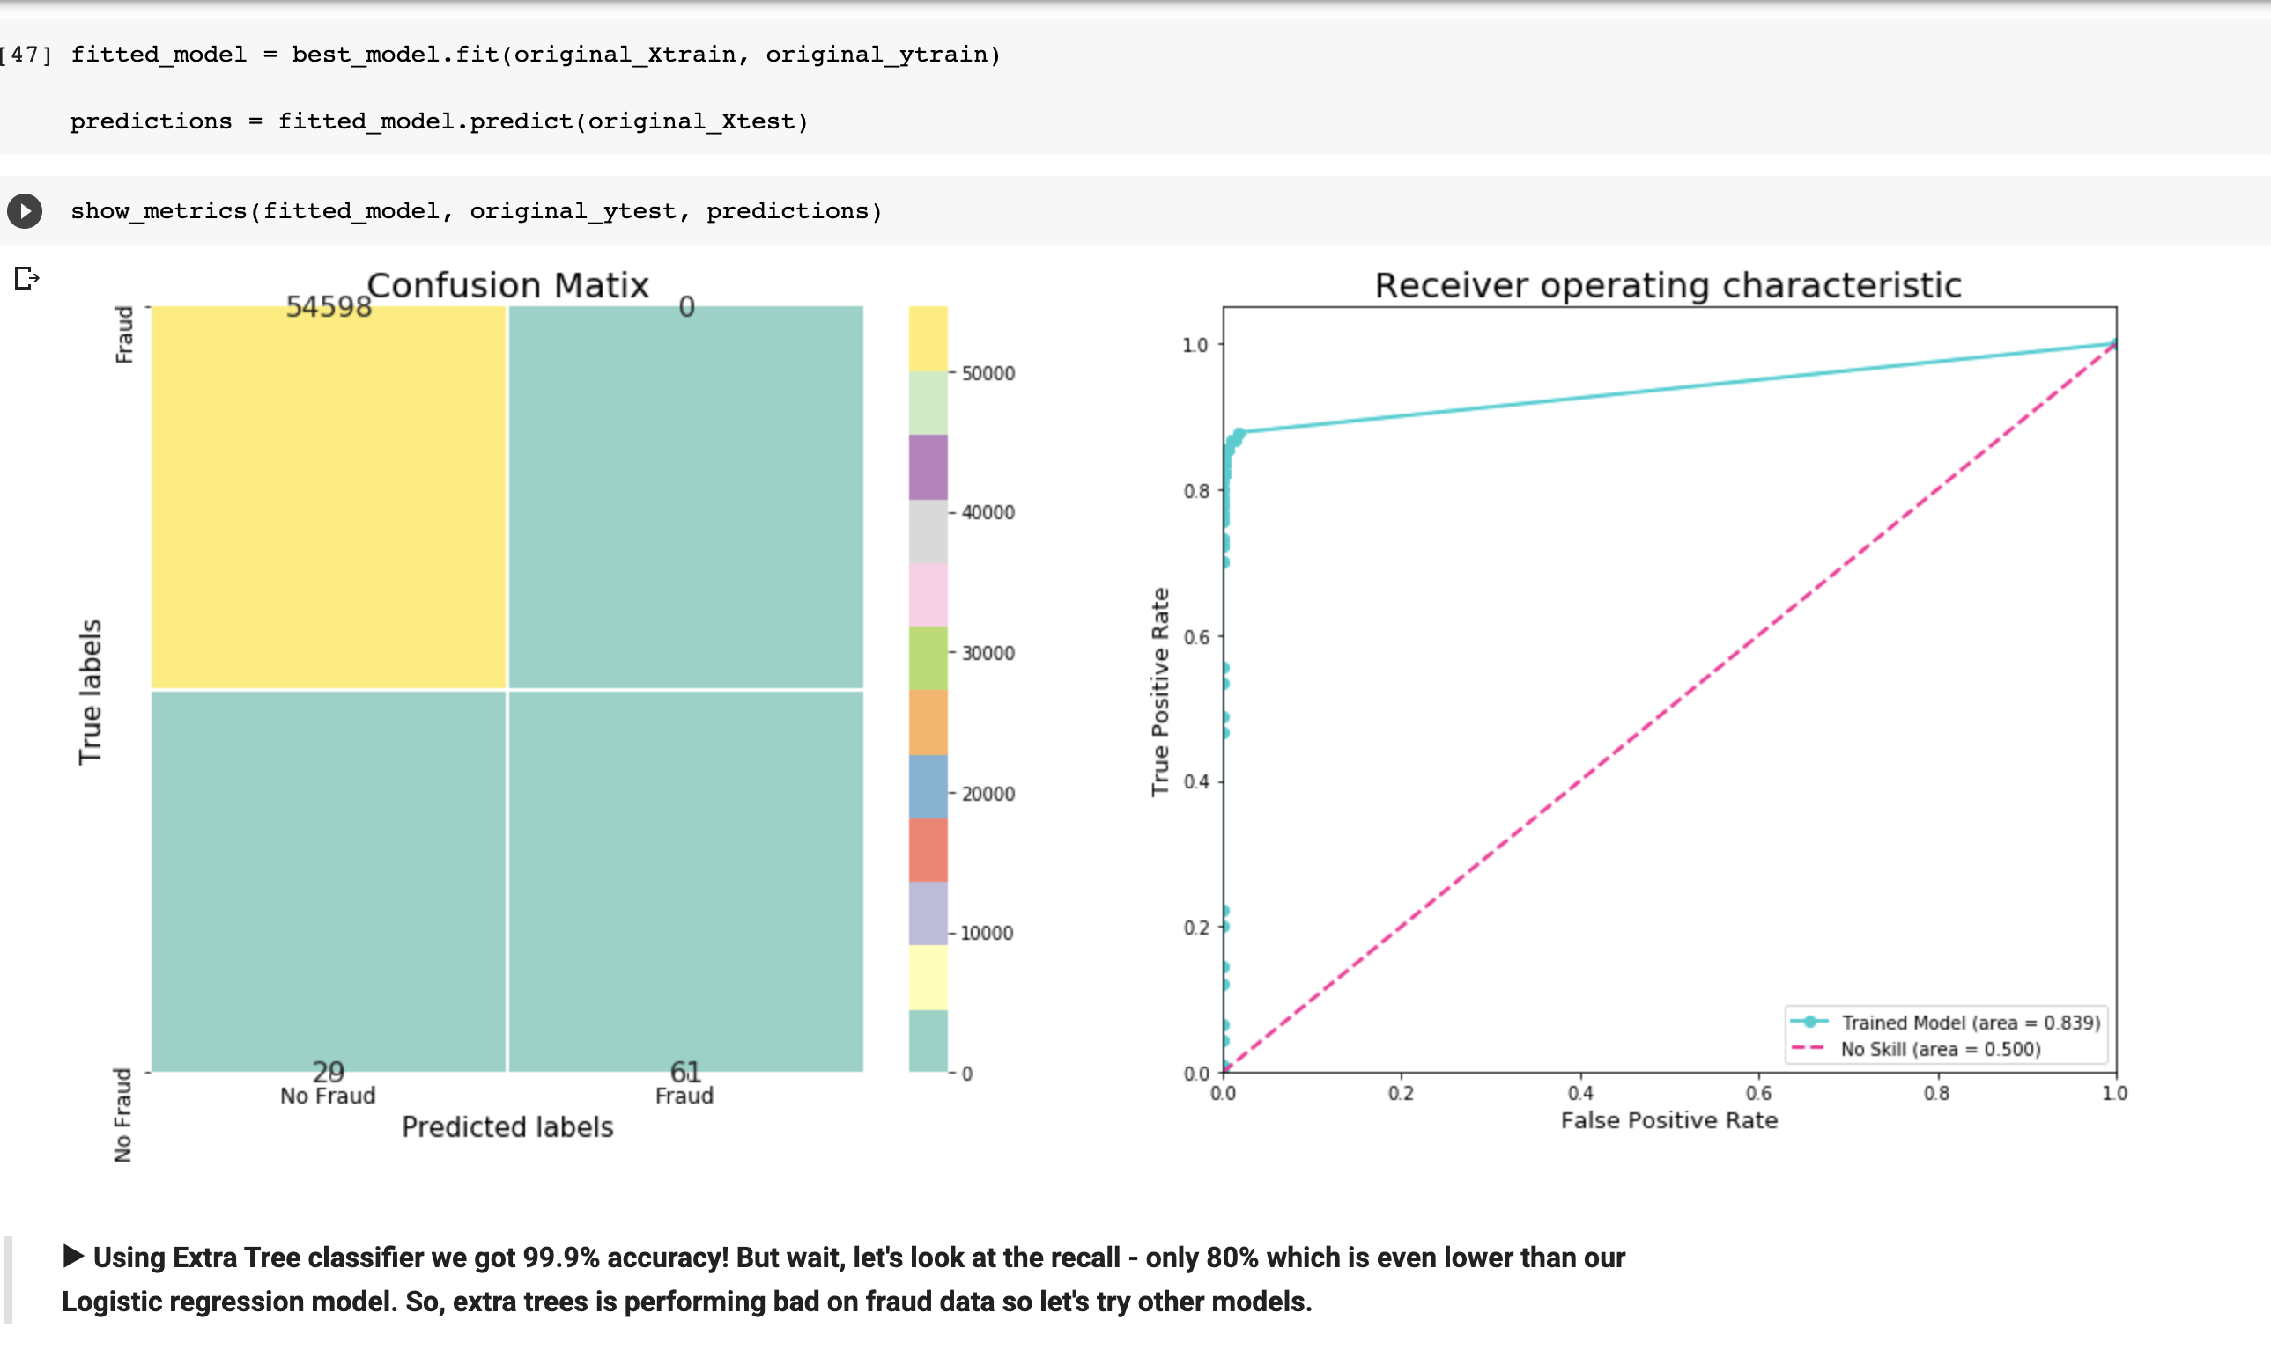
Using Extra Tree classifier we got 99.9% accuracy
But wait, let's look at the recall - only 80% which is even lower than our Logistic regression model.
So, extra trees is performing bad on fraud data so let's try other models.

Slide 35
Unsupervised learning - Isolation forest
Isolation Forest is an unsupervised anomaly detection algorithm that uses the two properties “Few” and “Different” of anomalies to detect their existence.
Since anomalies are few and different, they are more susceptible to isolation. This algorithm isolates each point in the data and splits them into outliers or inliers. This split depends on how long it takes to separate the points. If we try to separate a point which is obviously a non-outlier, it’ll have many points in its round, so that it will be really difficult to isolate. On the other hand, if the point is an outlier, it’ll be alone and we’ll find it very easily.

Slide 36
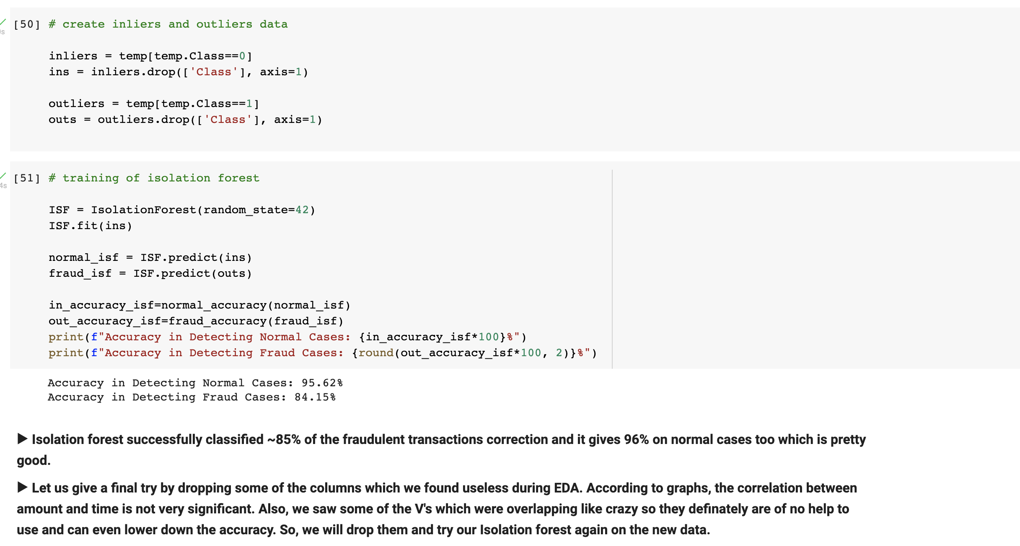

Slide 37
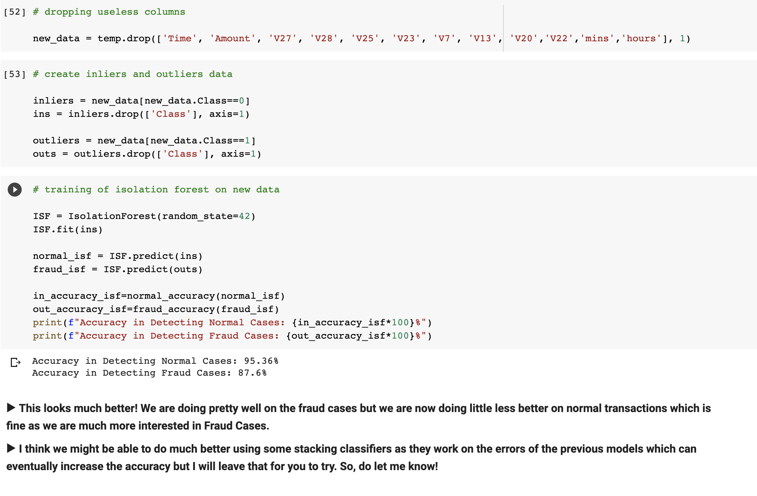

Slide 38
autoencoders

Slide 39
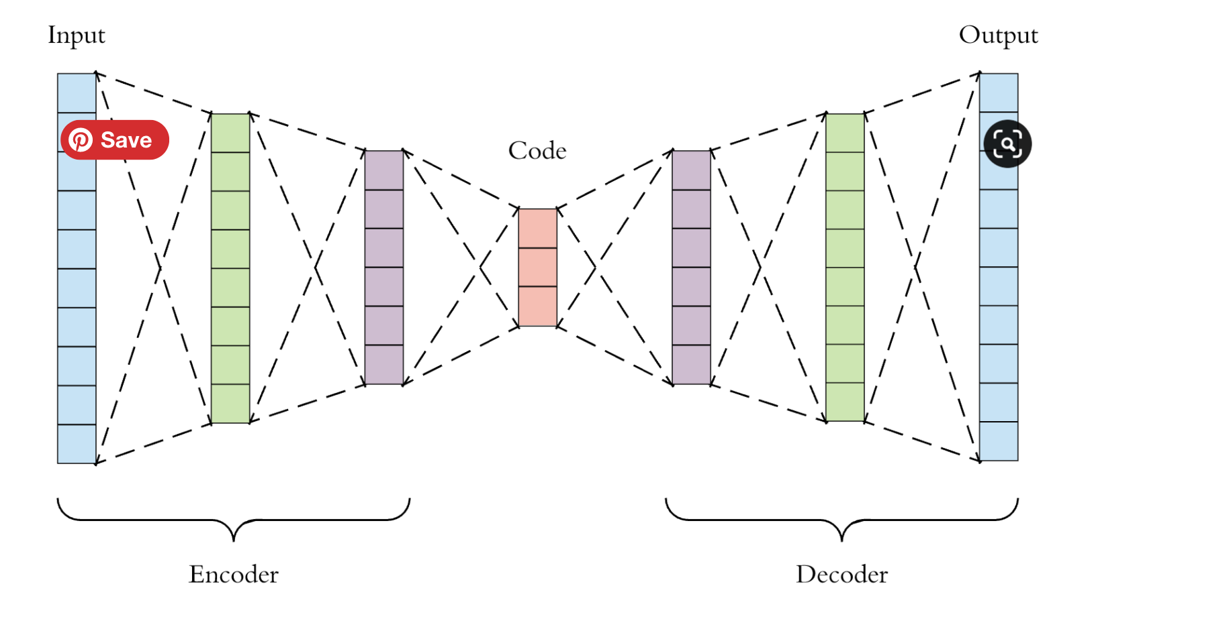
Autoencoders – architecture

Slide 40
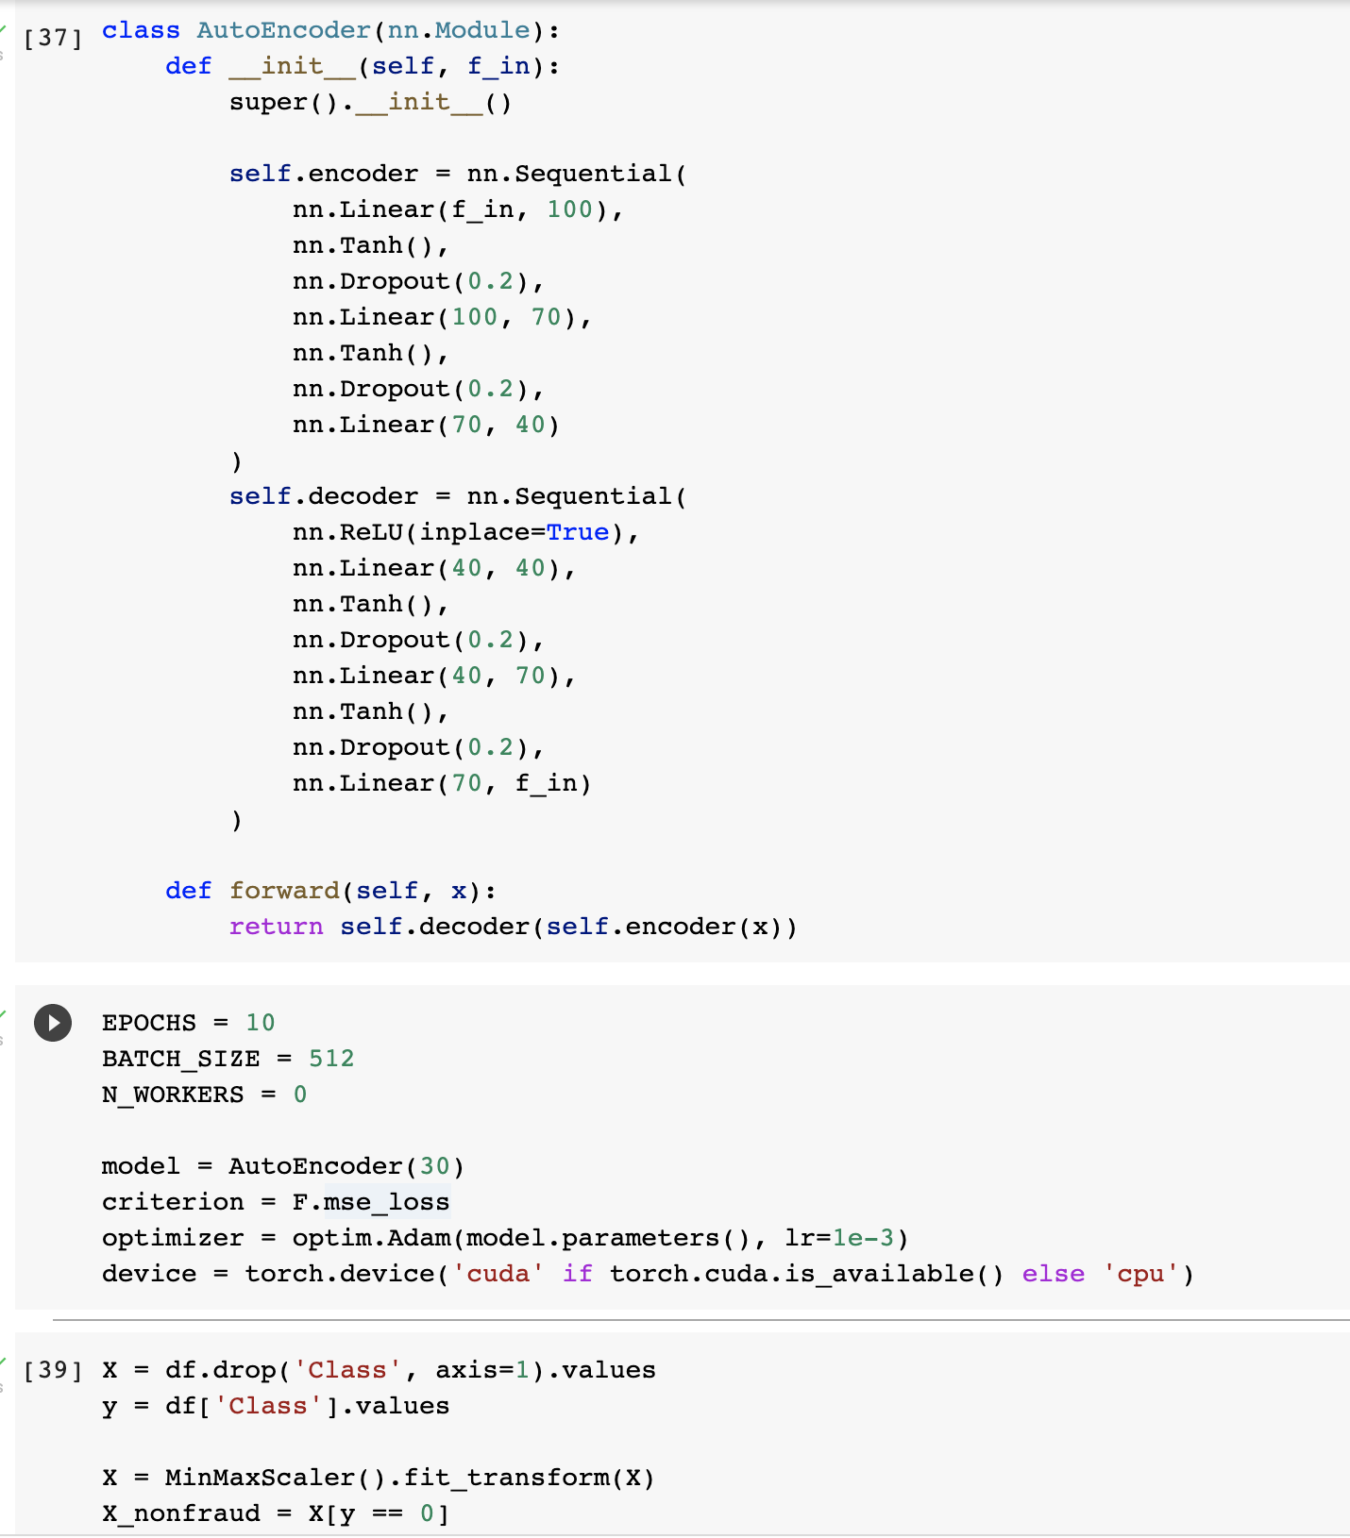
Neural network - encoder and decoder

Slide 41
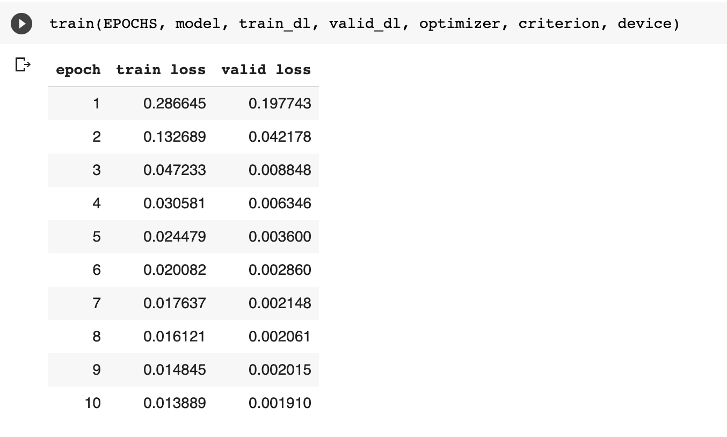
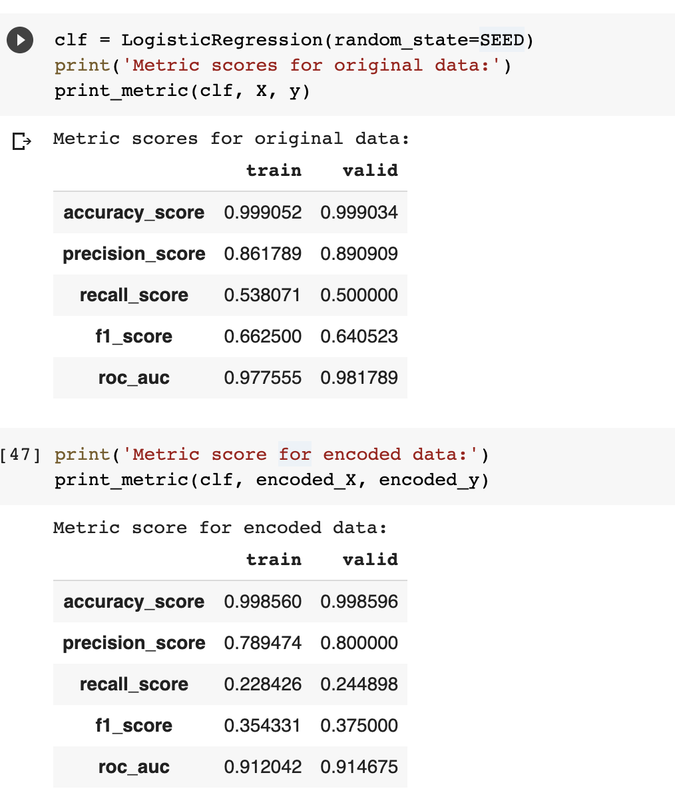
inferance

Slide 42

Summary

Slide 43
Summary
ExtraTreesClassifier is the best model with Accuracy: 99.92% , Precision: 0.79 , Recall: 0.80 & f1 Score: 0.78
As per permutation importance fields such as 'V14', 'V4', 'V17', 'Amount', 'V19', 'V13’ have strong predictive power
Isolation forest model having
Accuracy in Detecting Normal Cases: 95.36%
Accuracy in Detecting Fraud Cases: 87.6%

